Slide 1


Slide 2
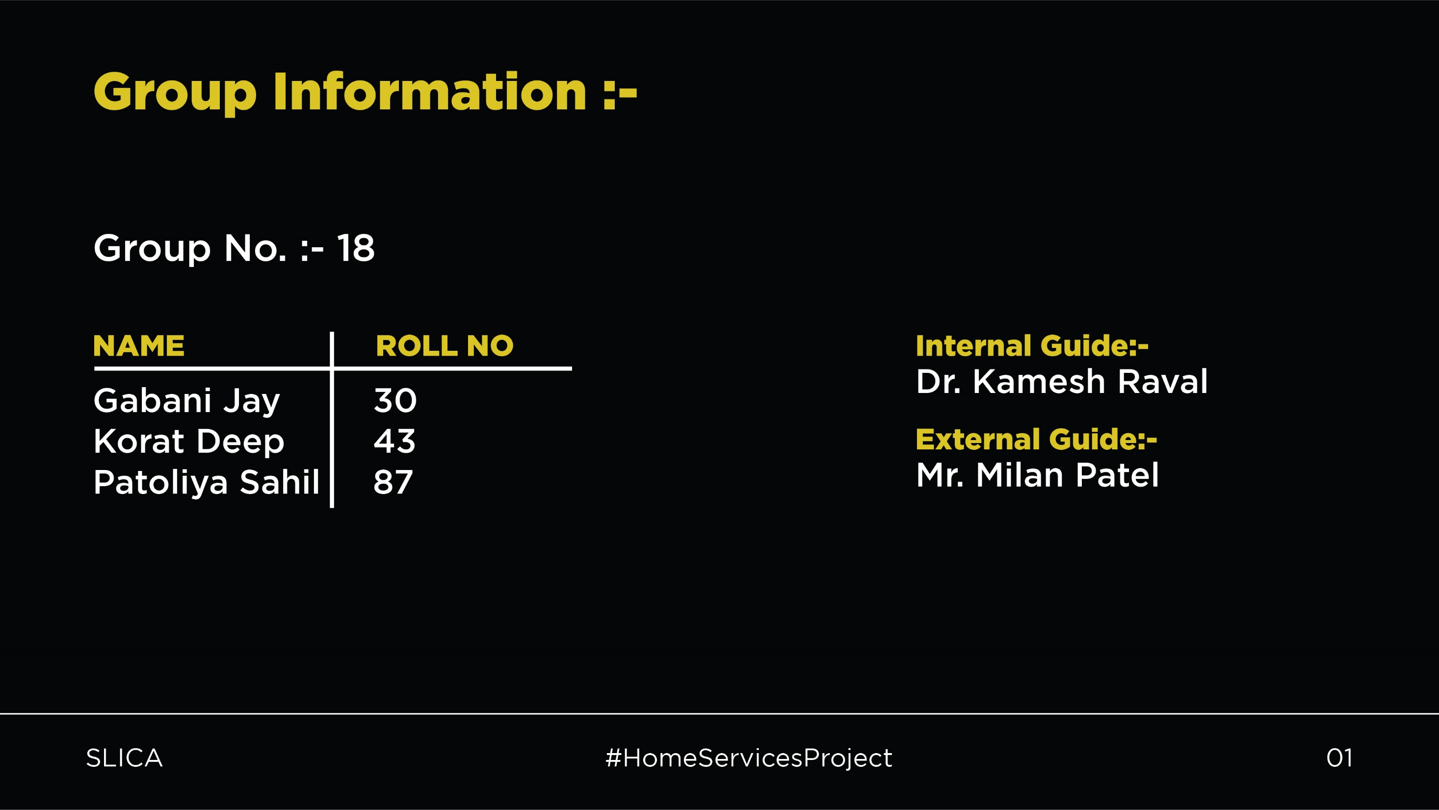

Slide 3


Slide 4


Slide 5
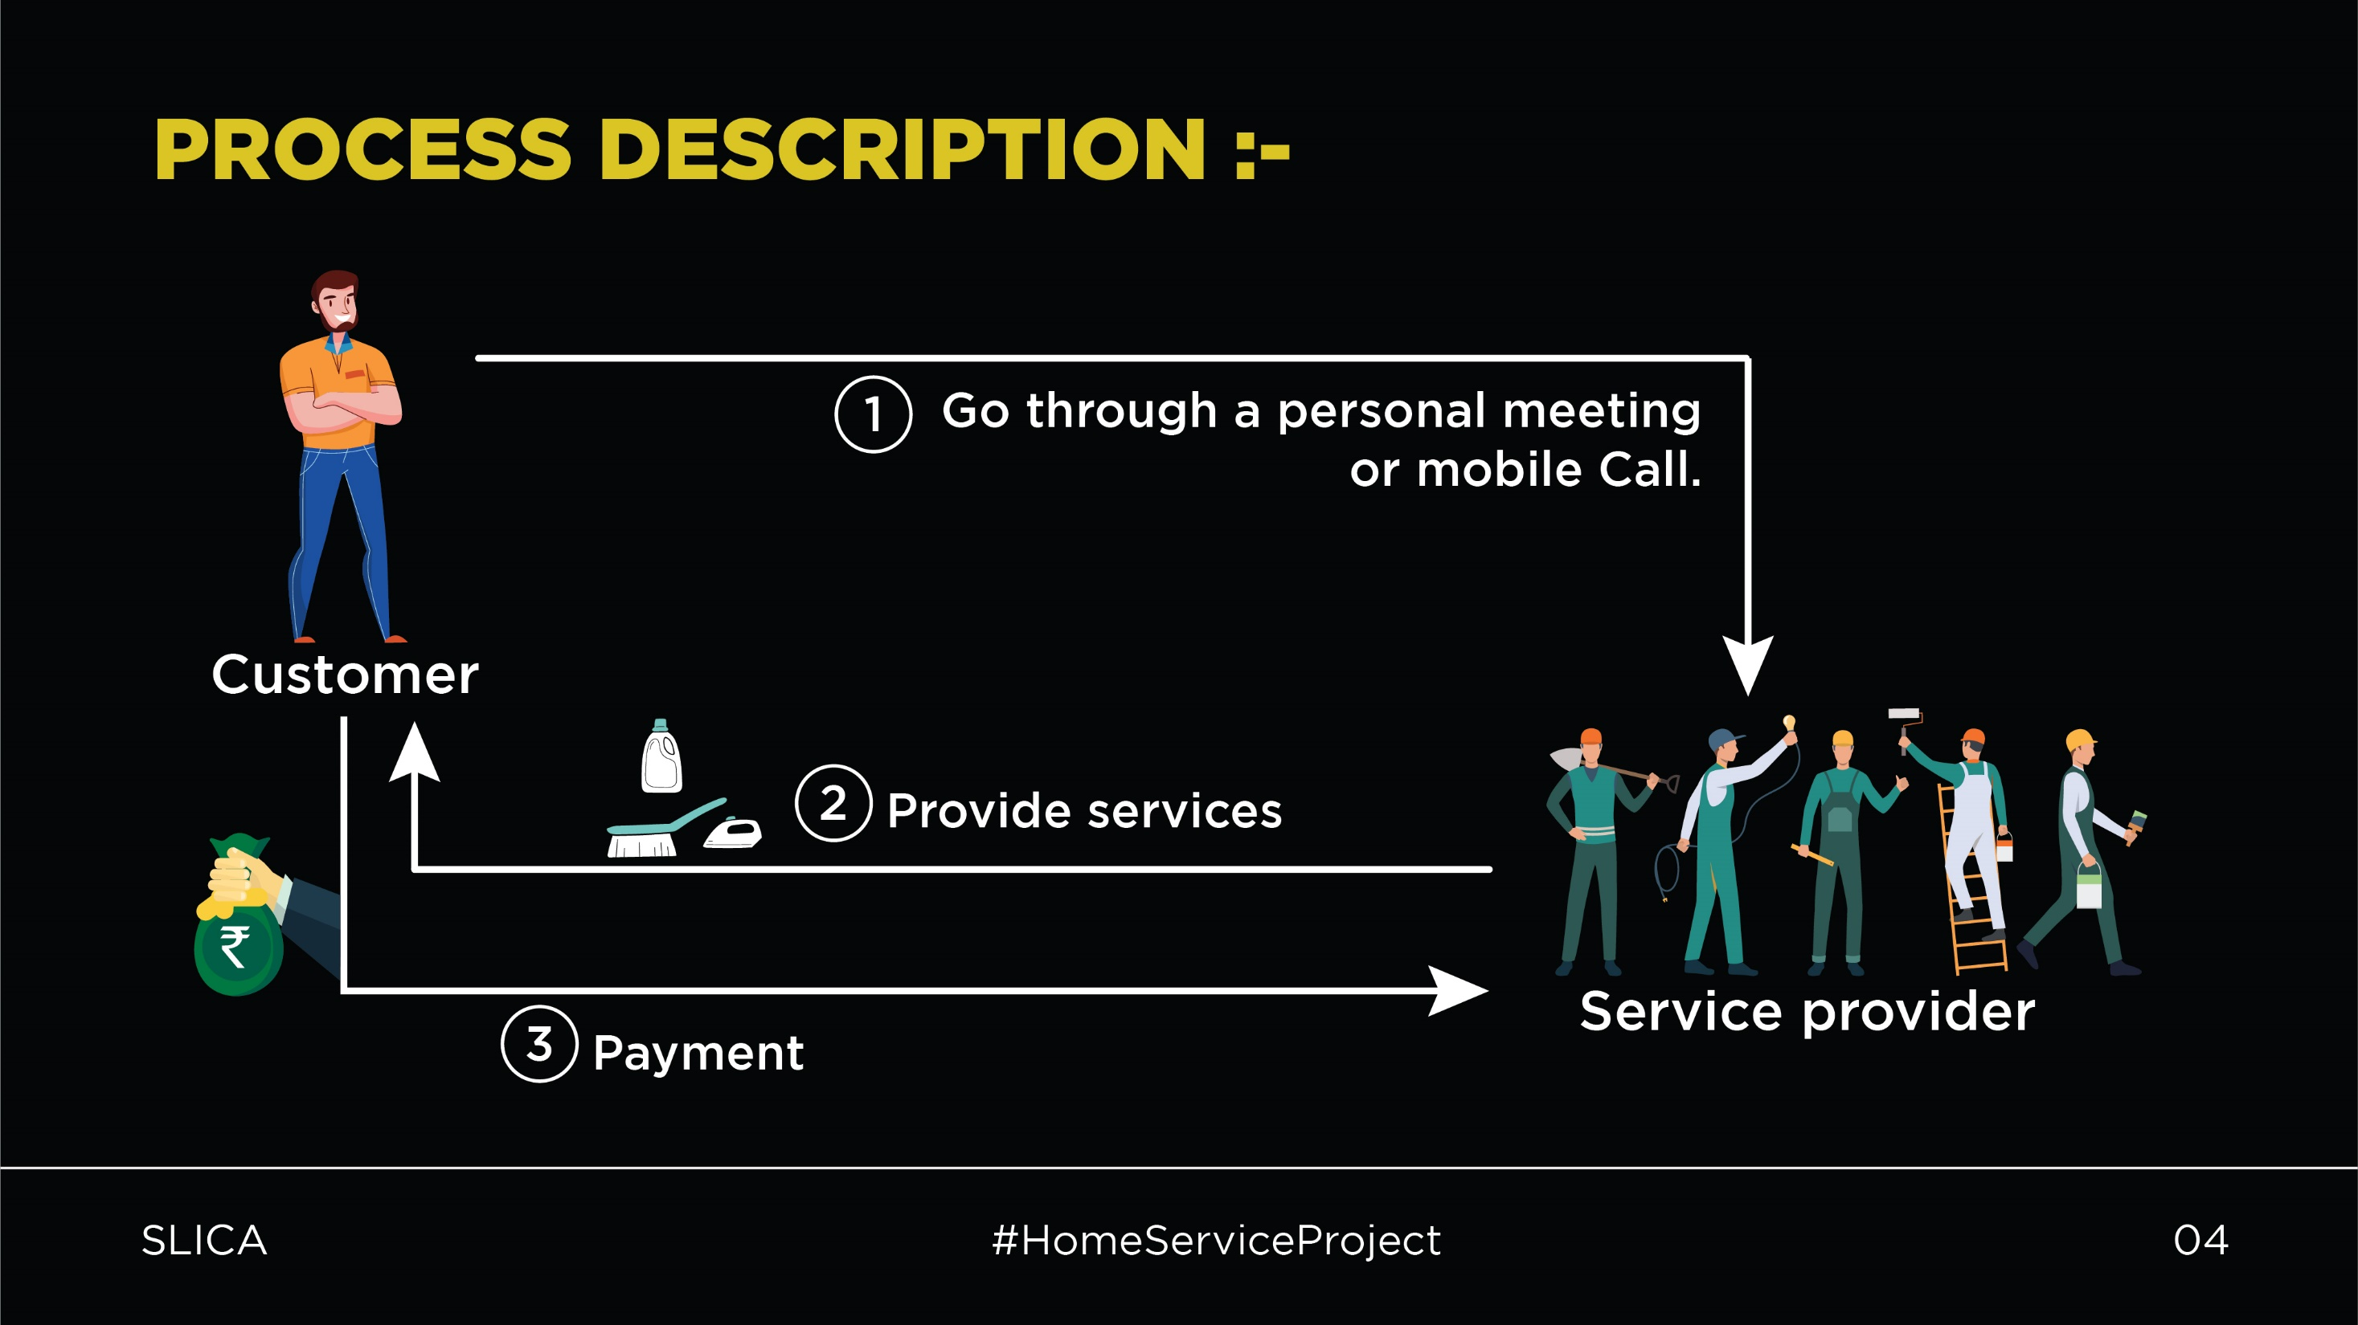

Slide 6
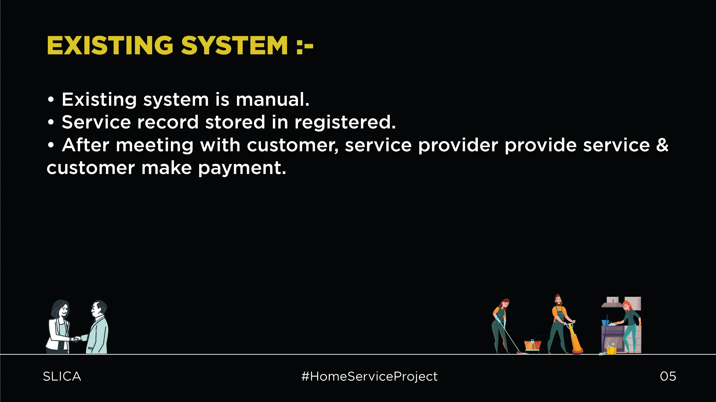

Slide 7
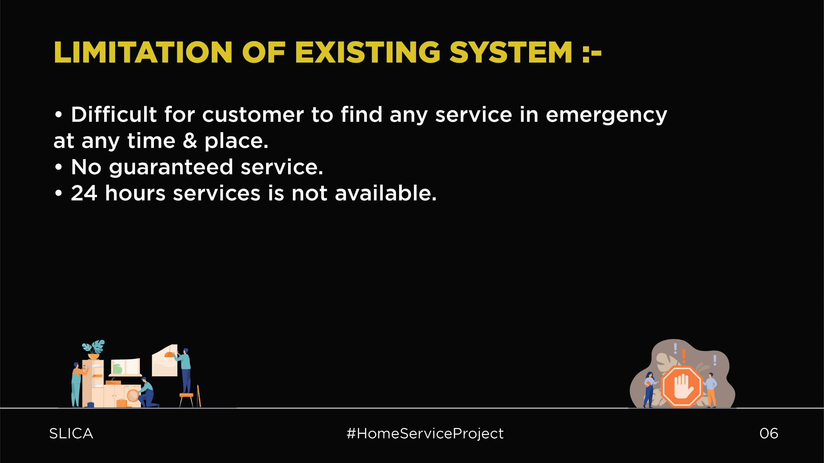

Slide 8


Slide 9
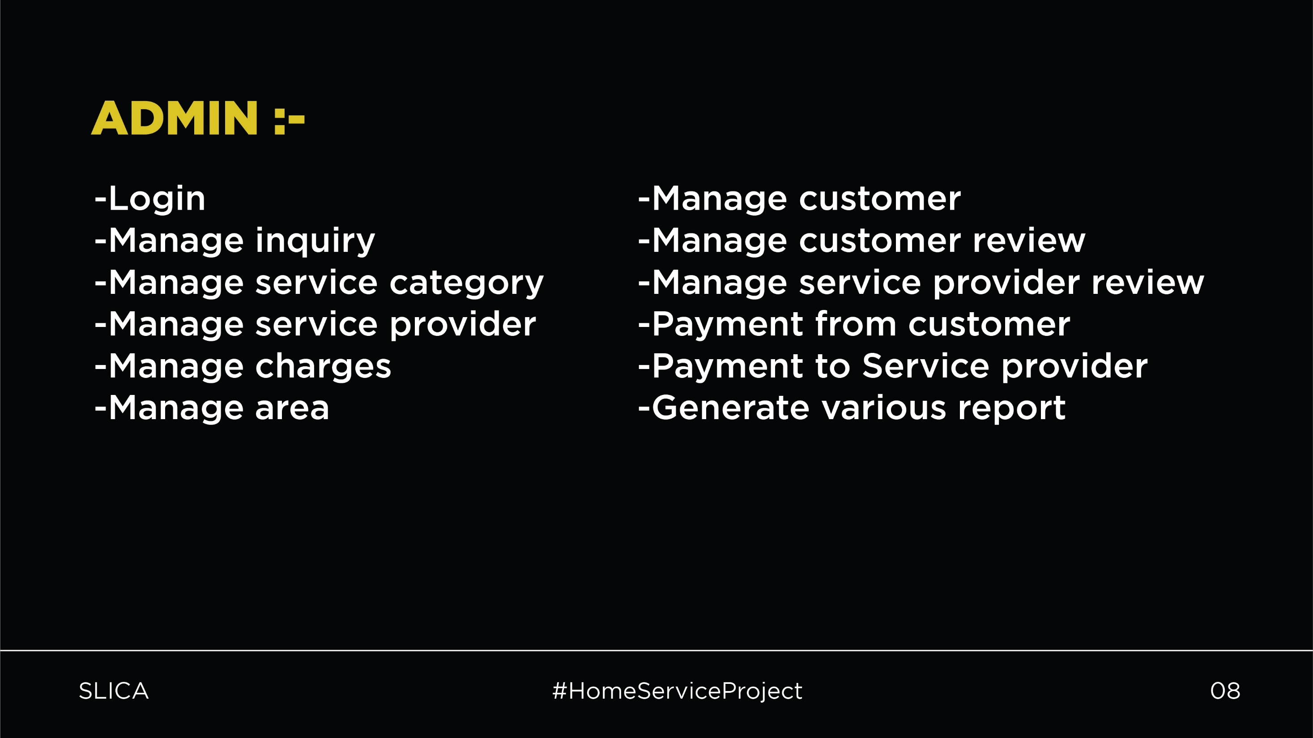

Slide 10
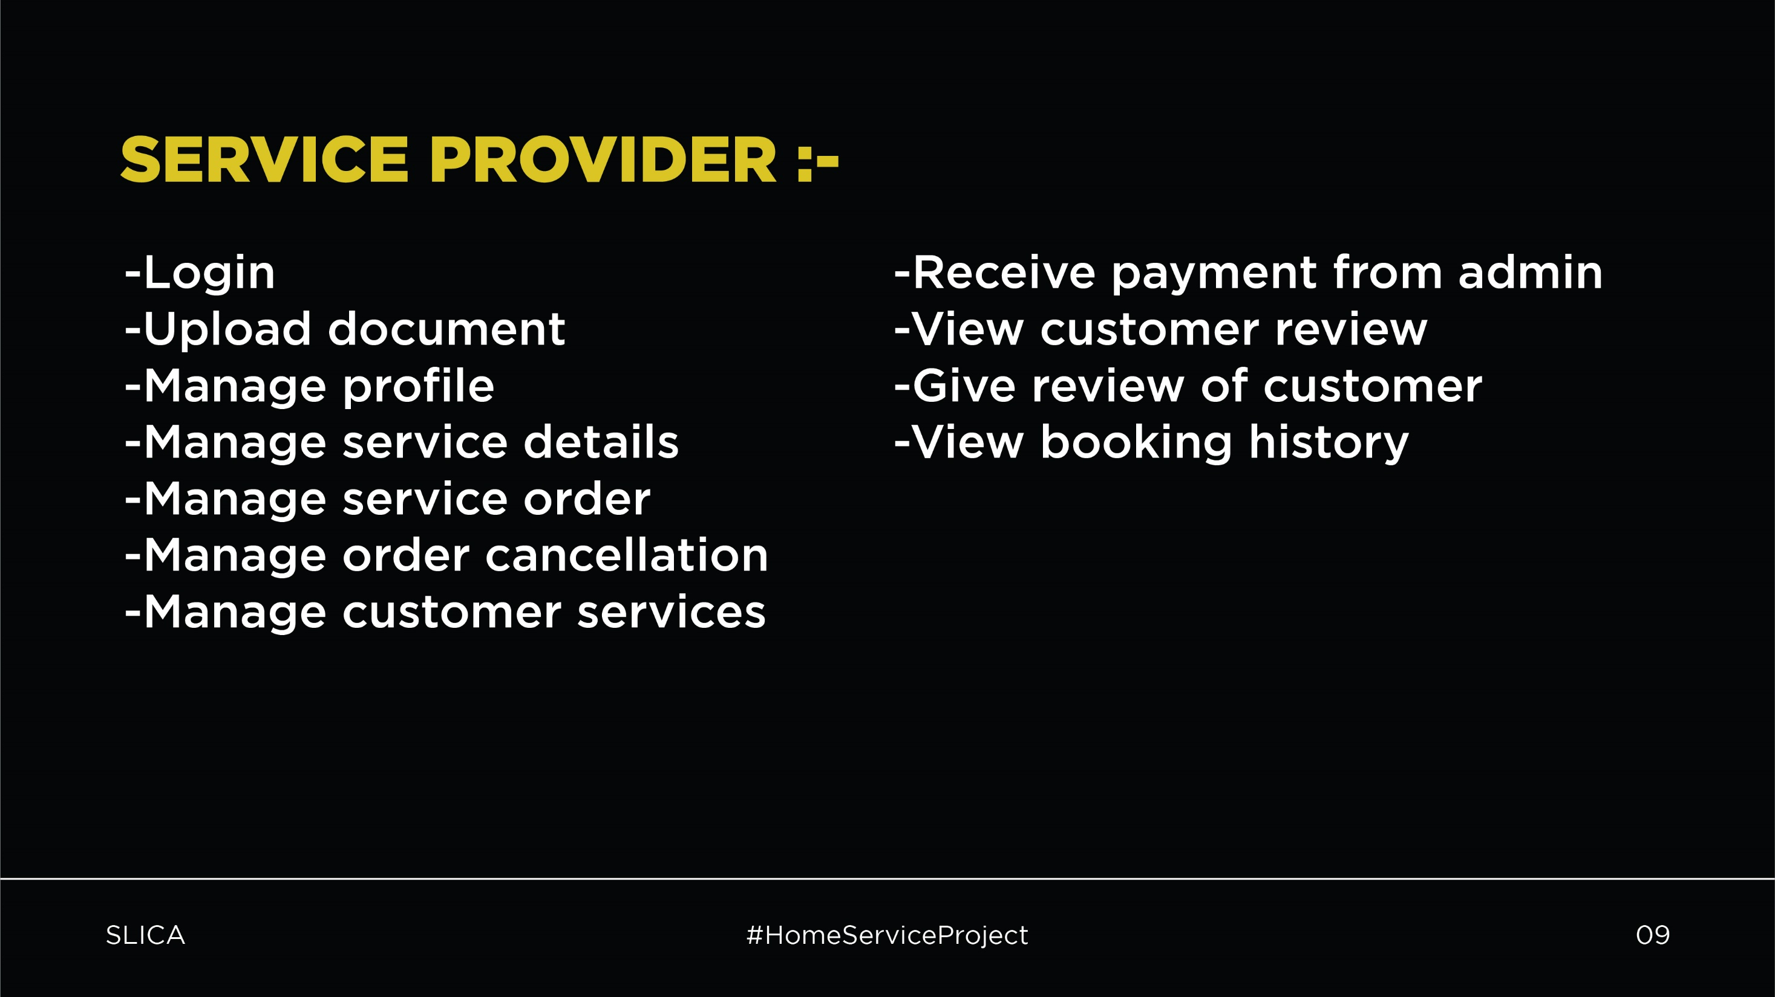

Slide 11
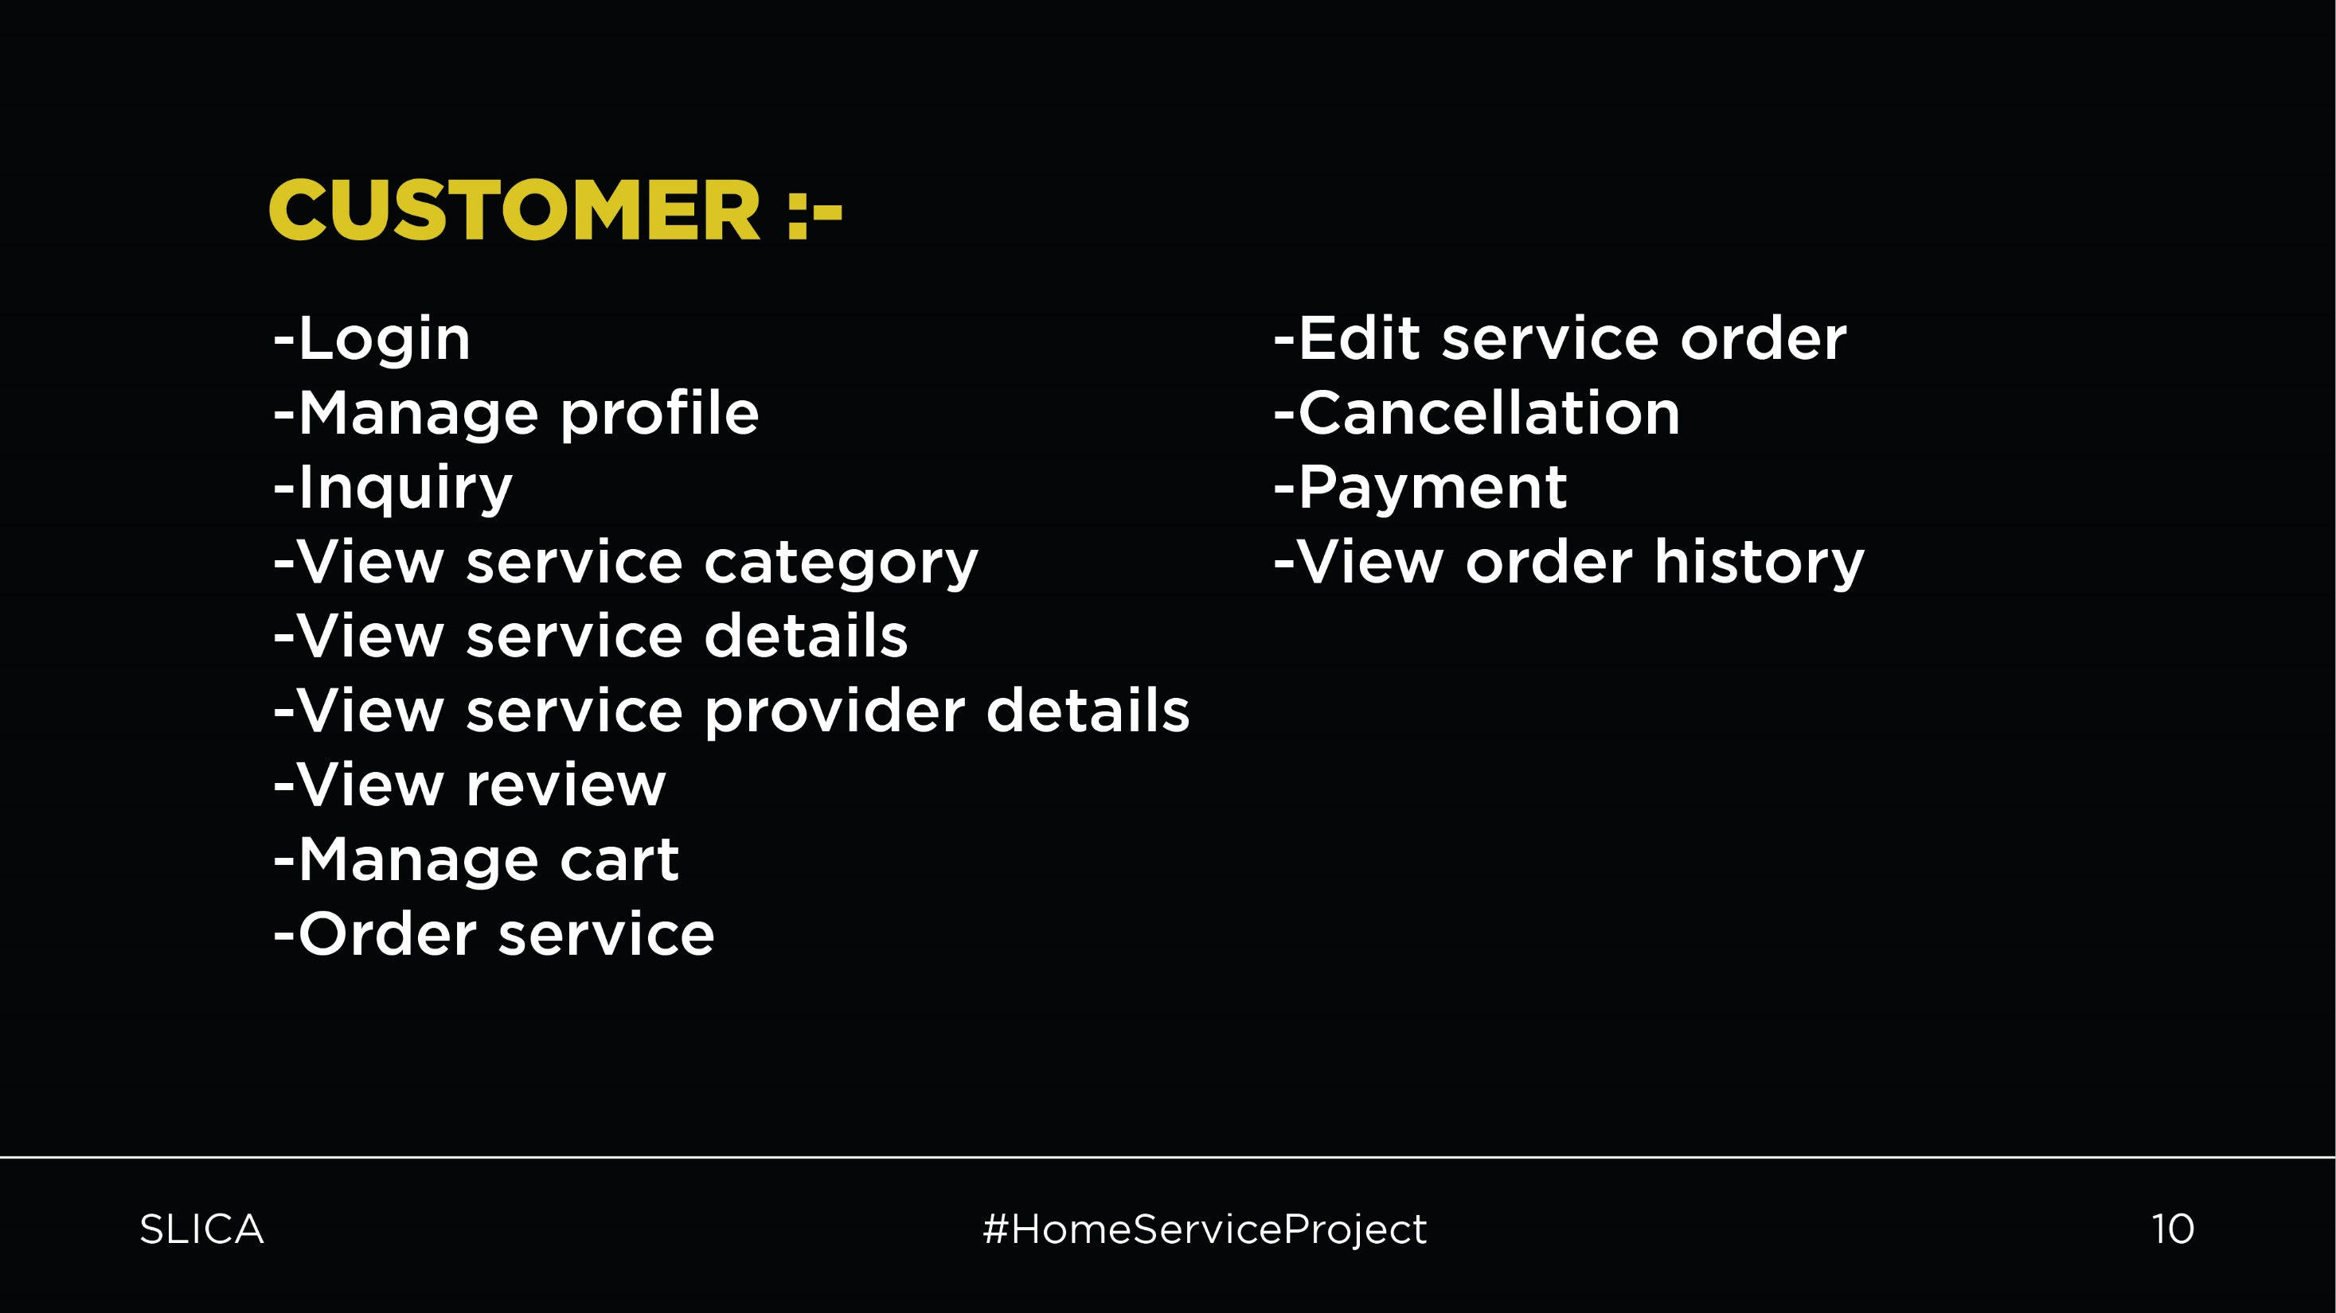

Slide 12
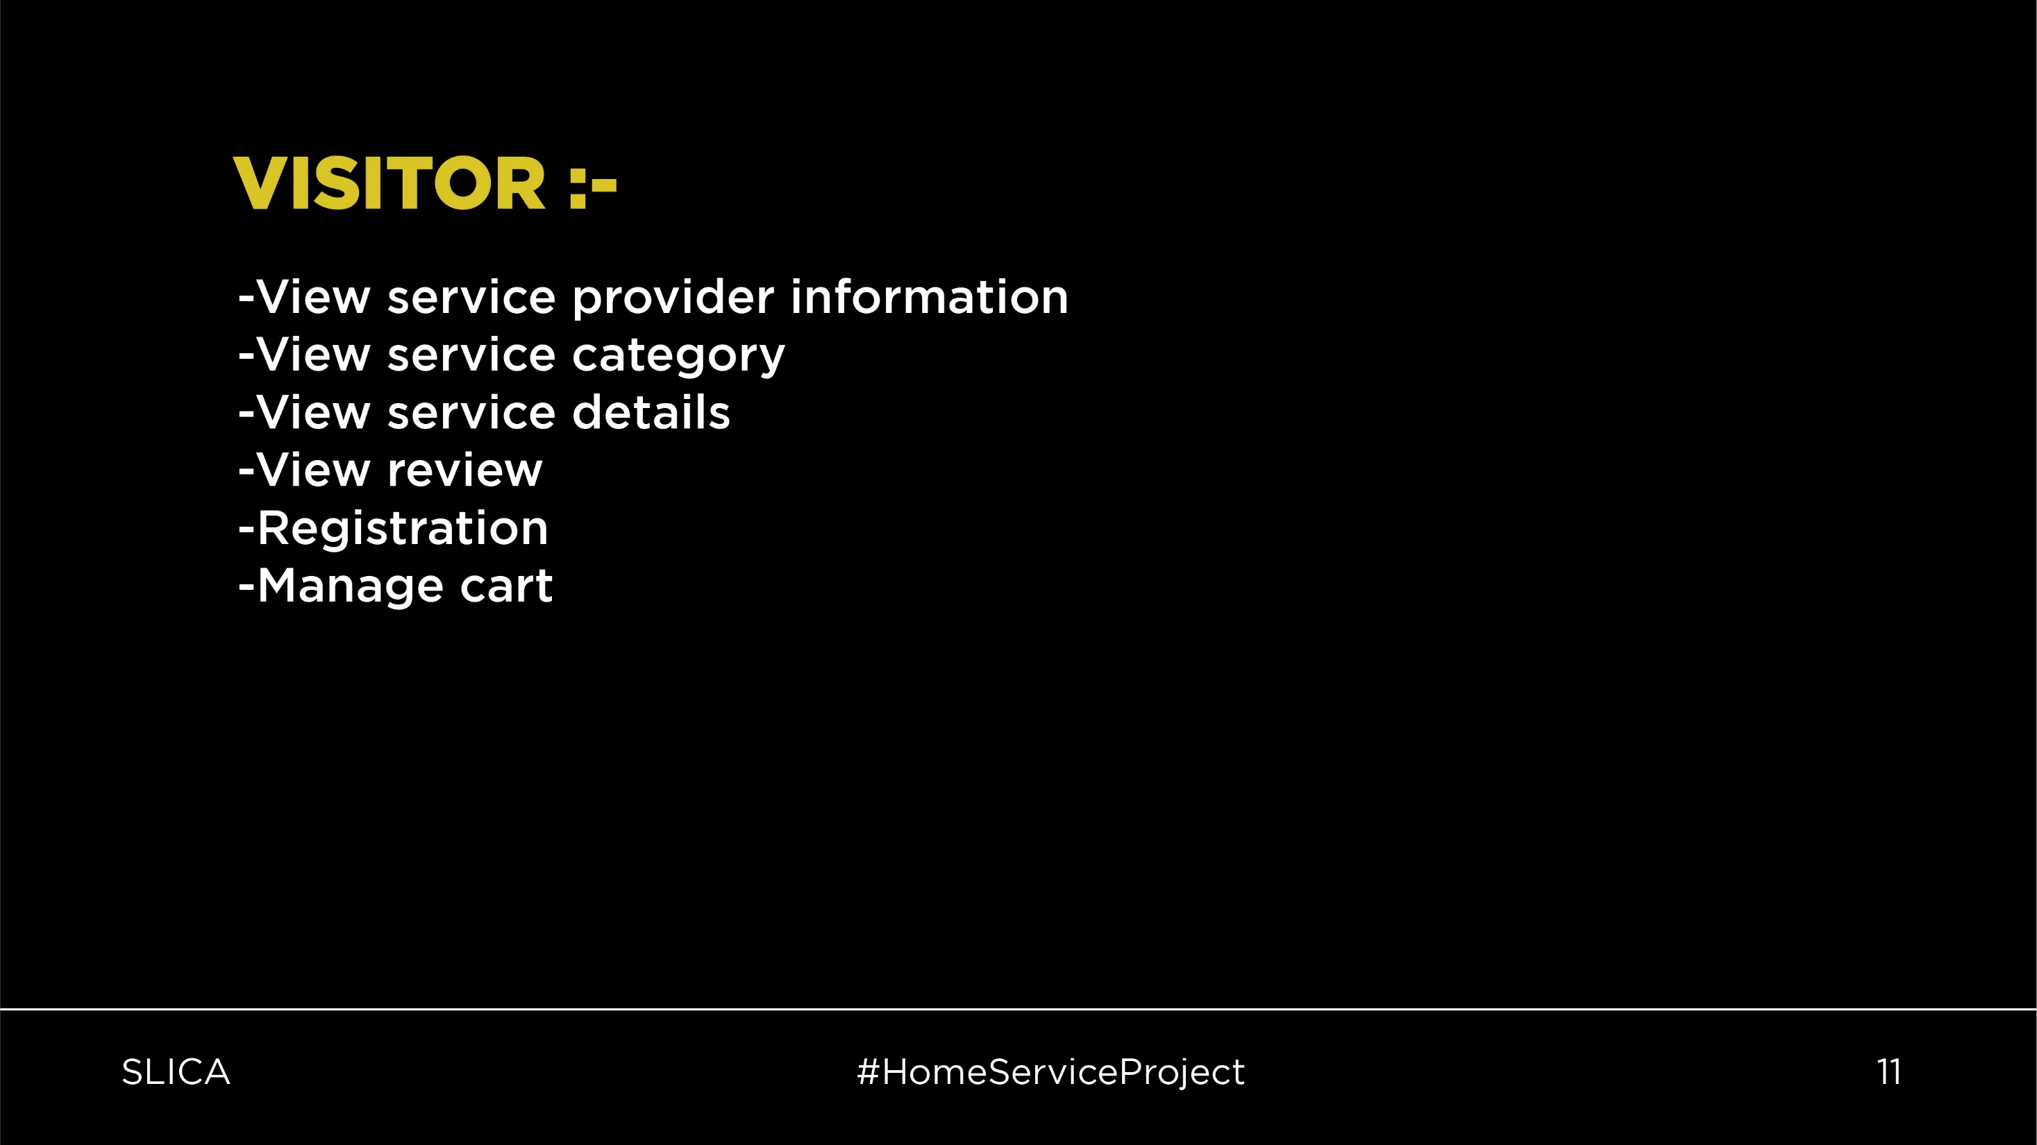

Slide 13
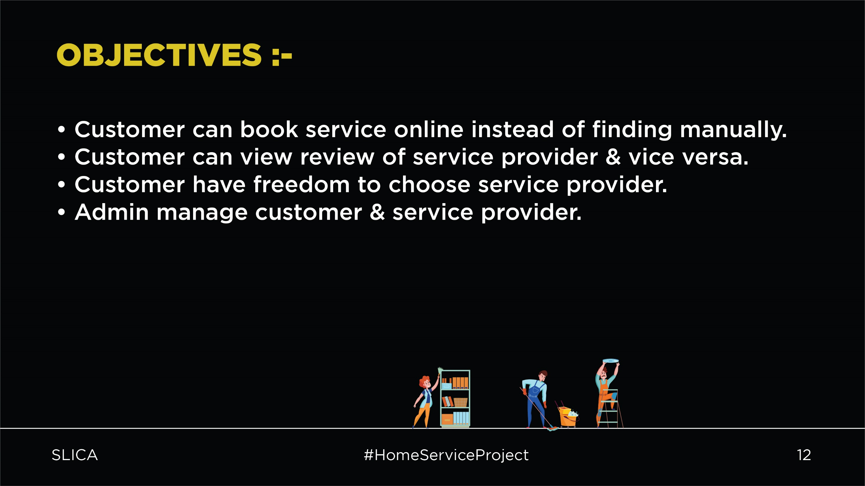

Slide 14
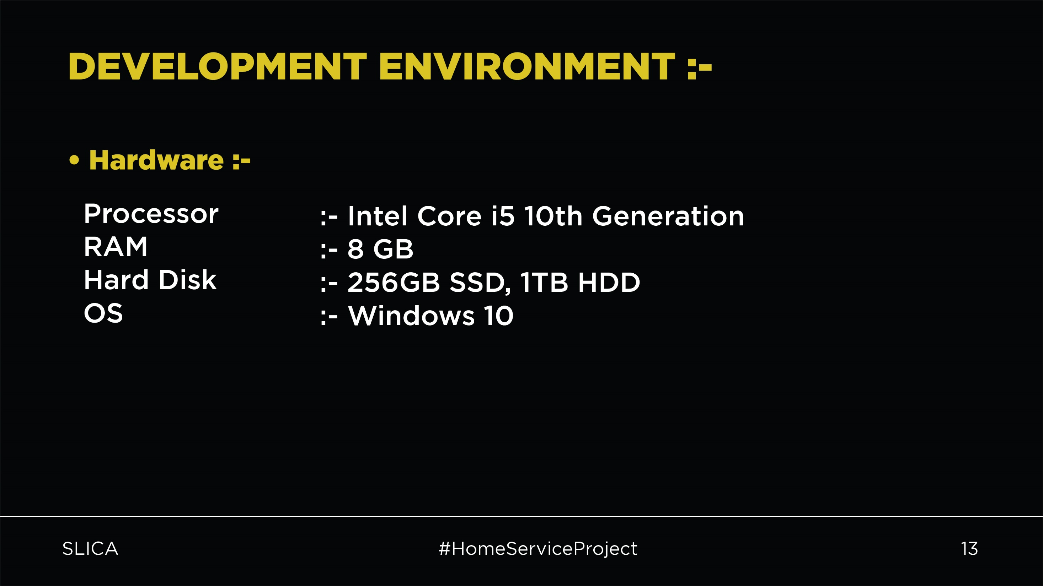

Slide 15
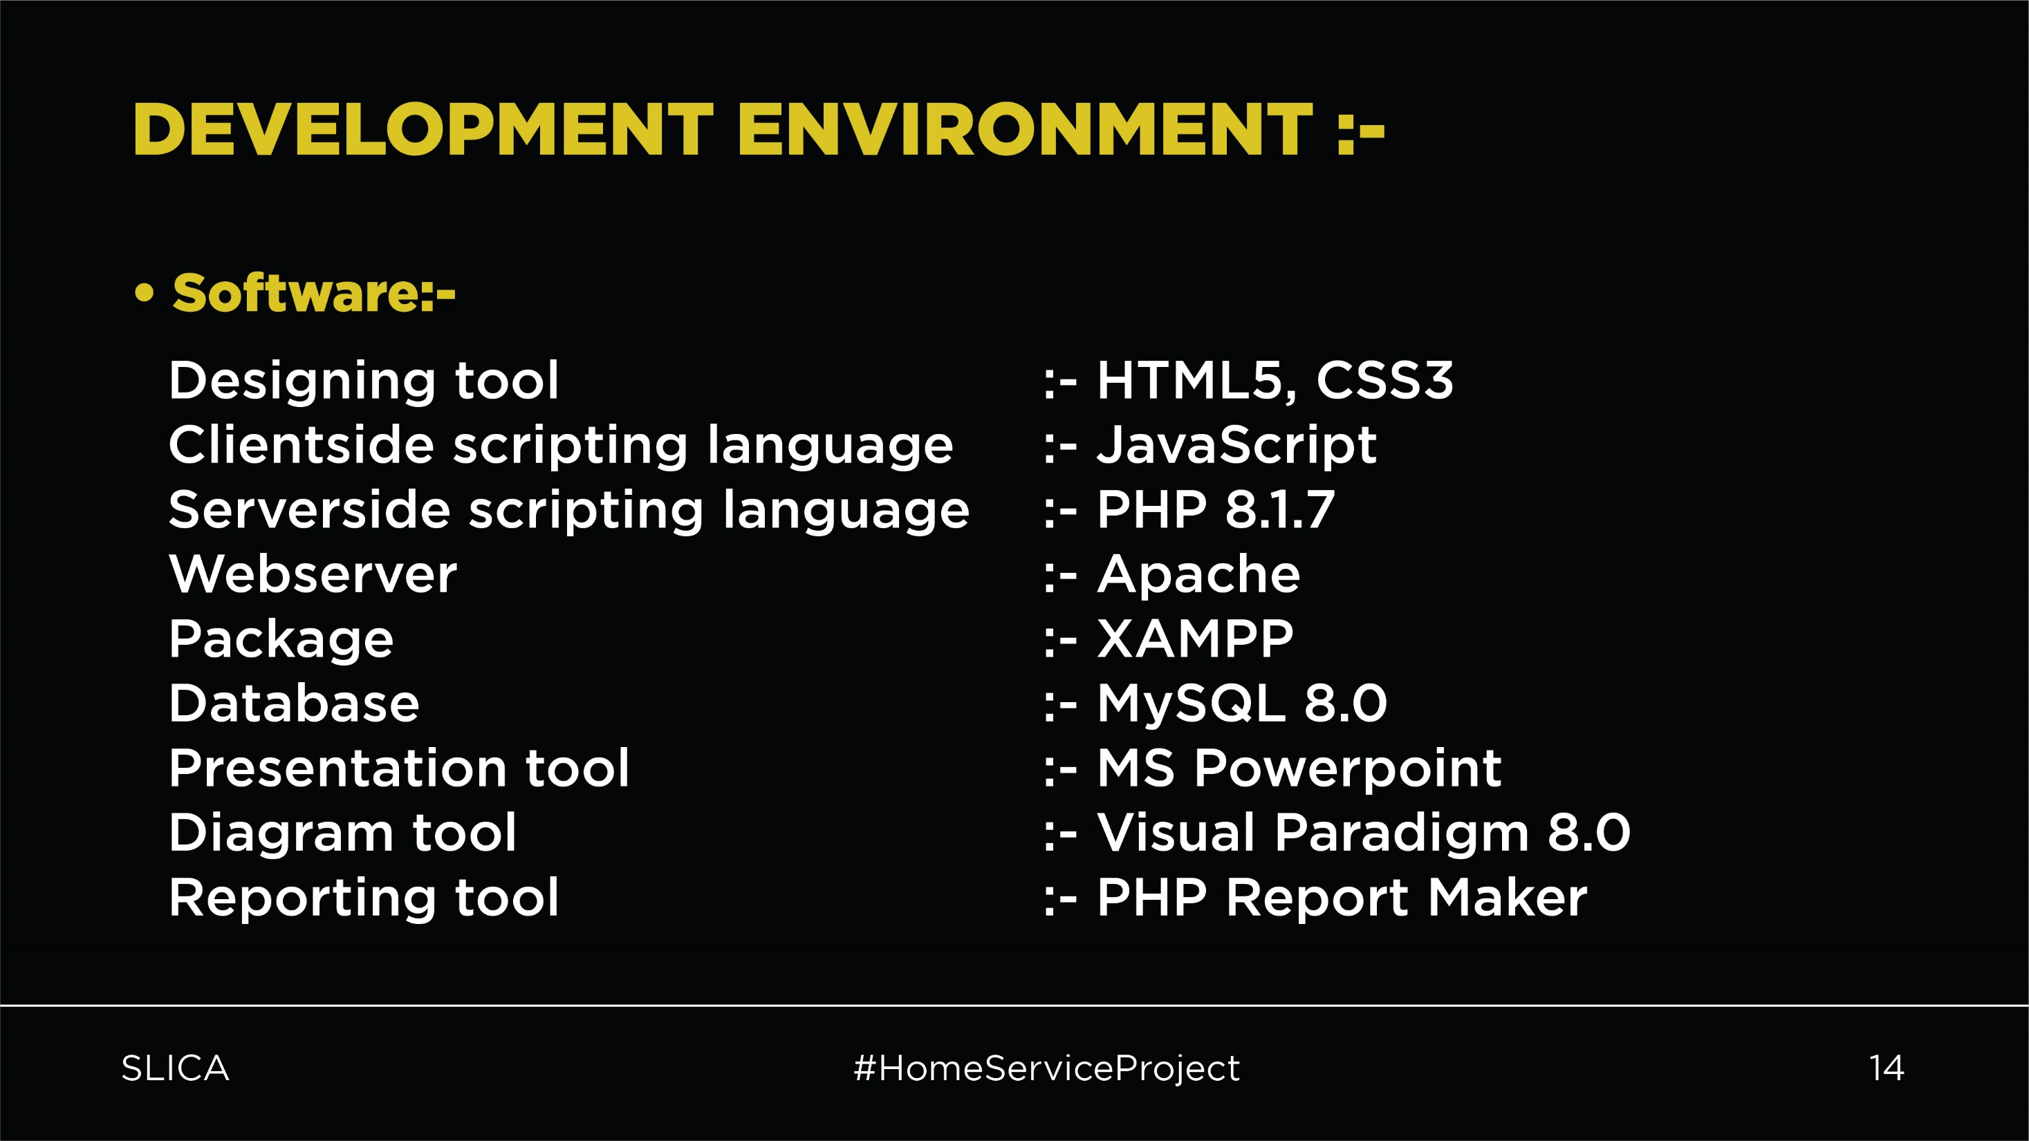

Slide 16
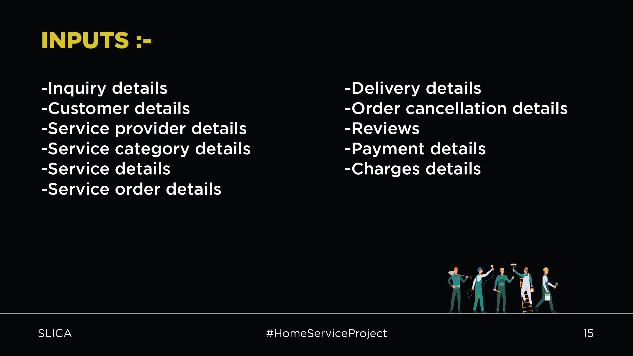

Slide 17
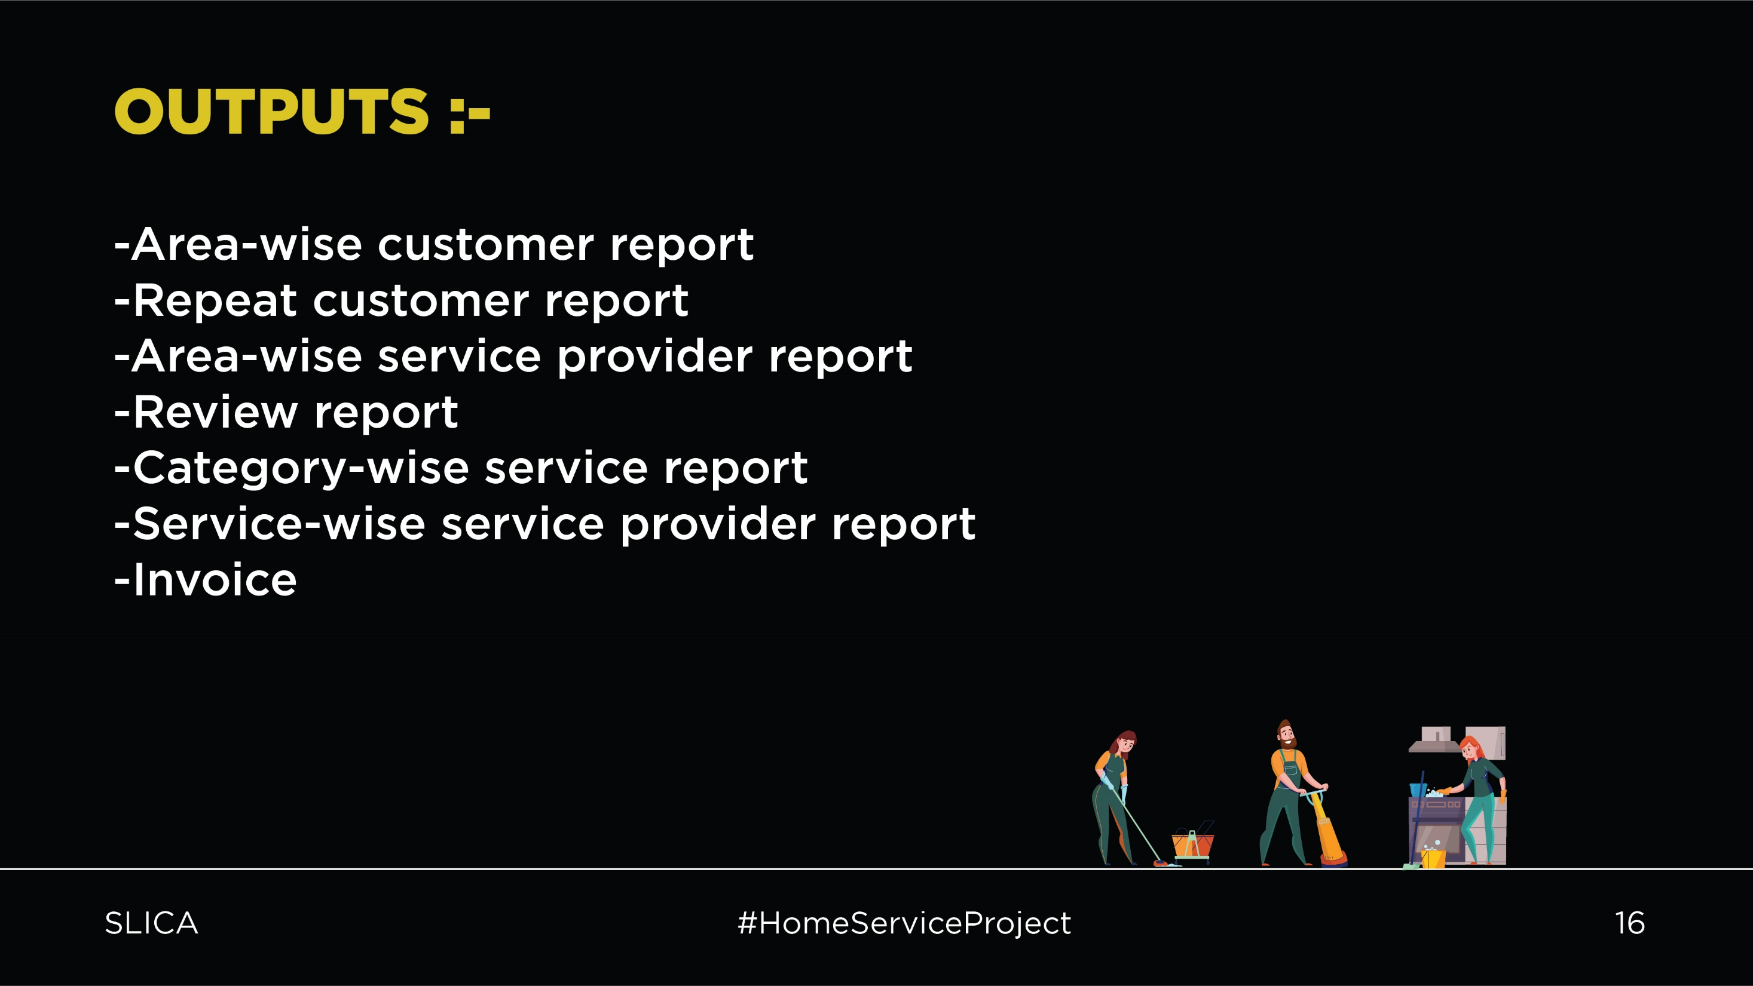

Slide 18


Slide 19
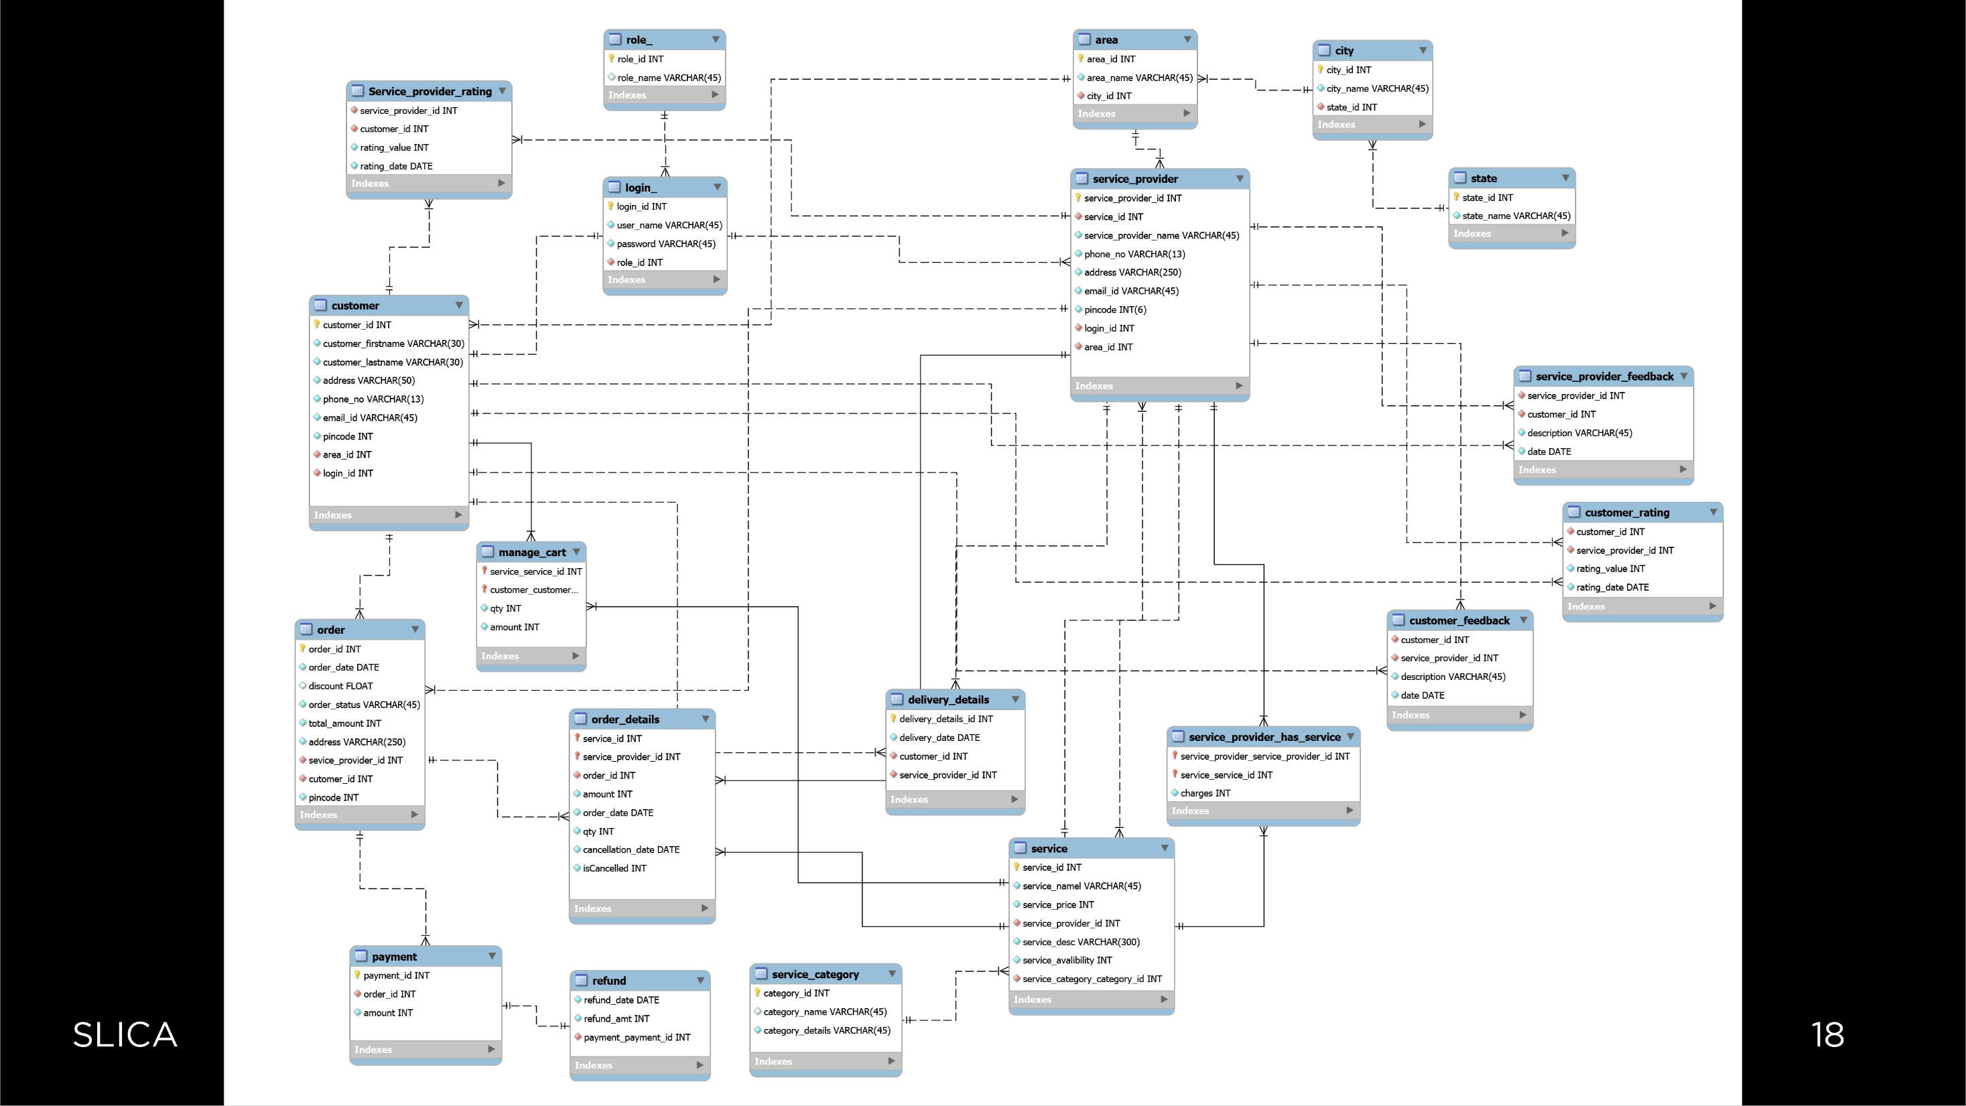

Slide 20


Slide 21
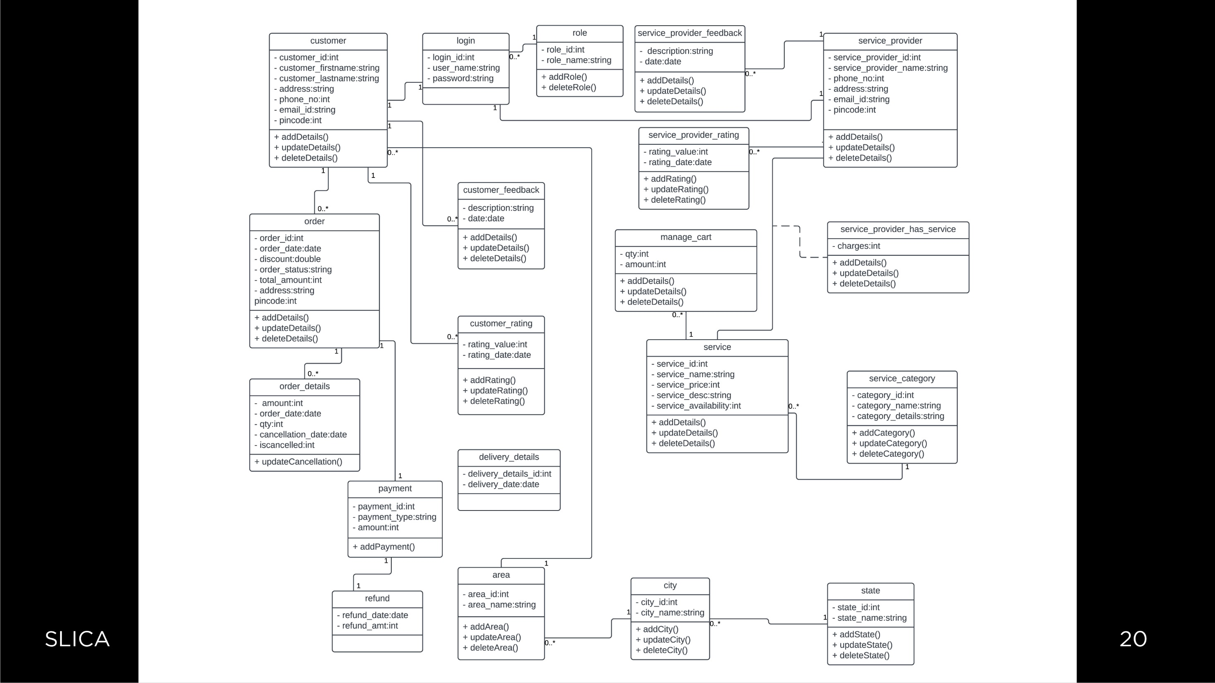

Slide 22


Slide 23
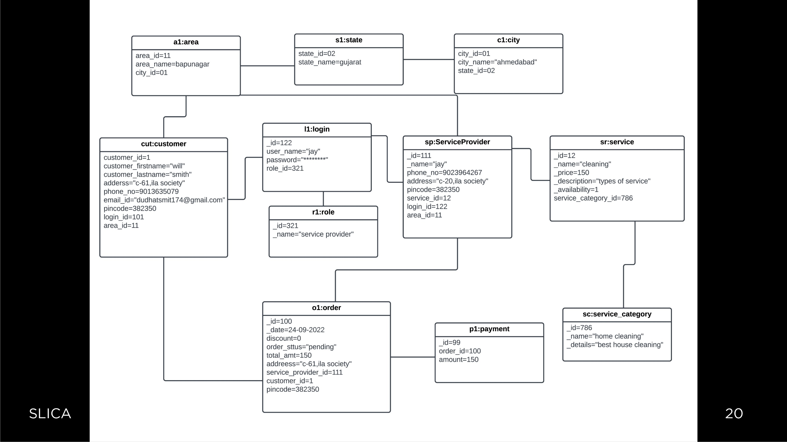

Slide 24


Slide 25
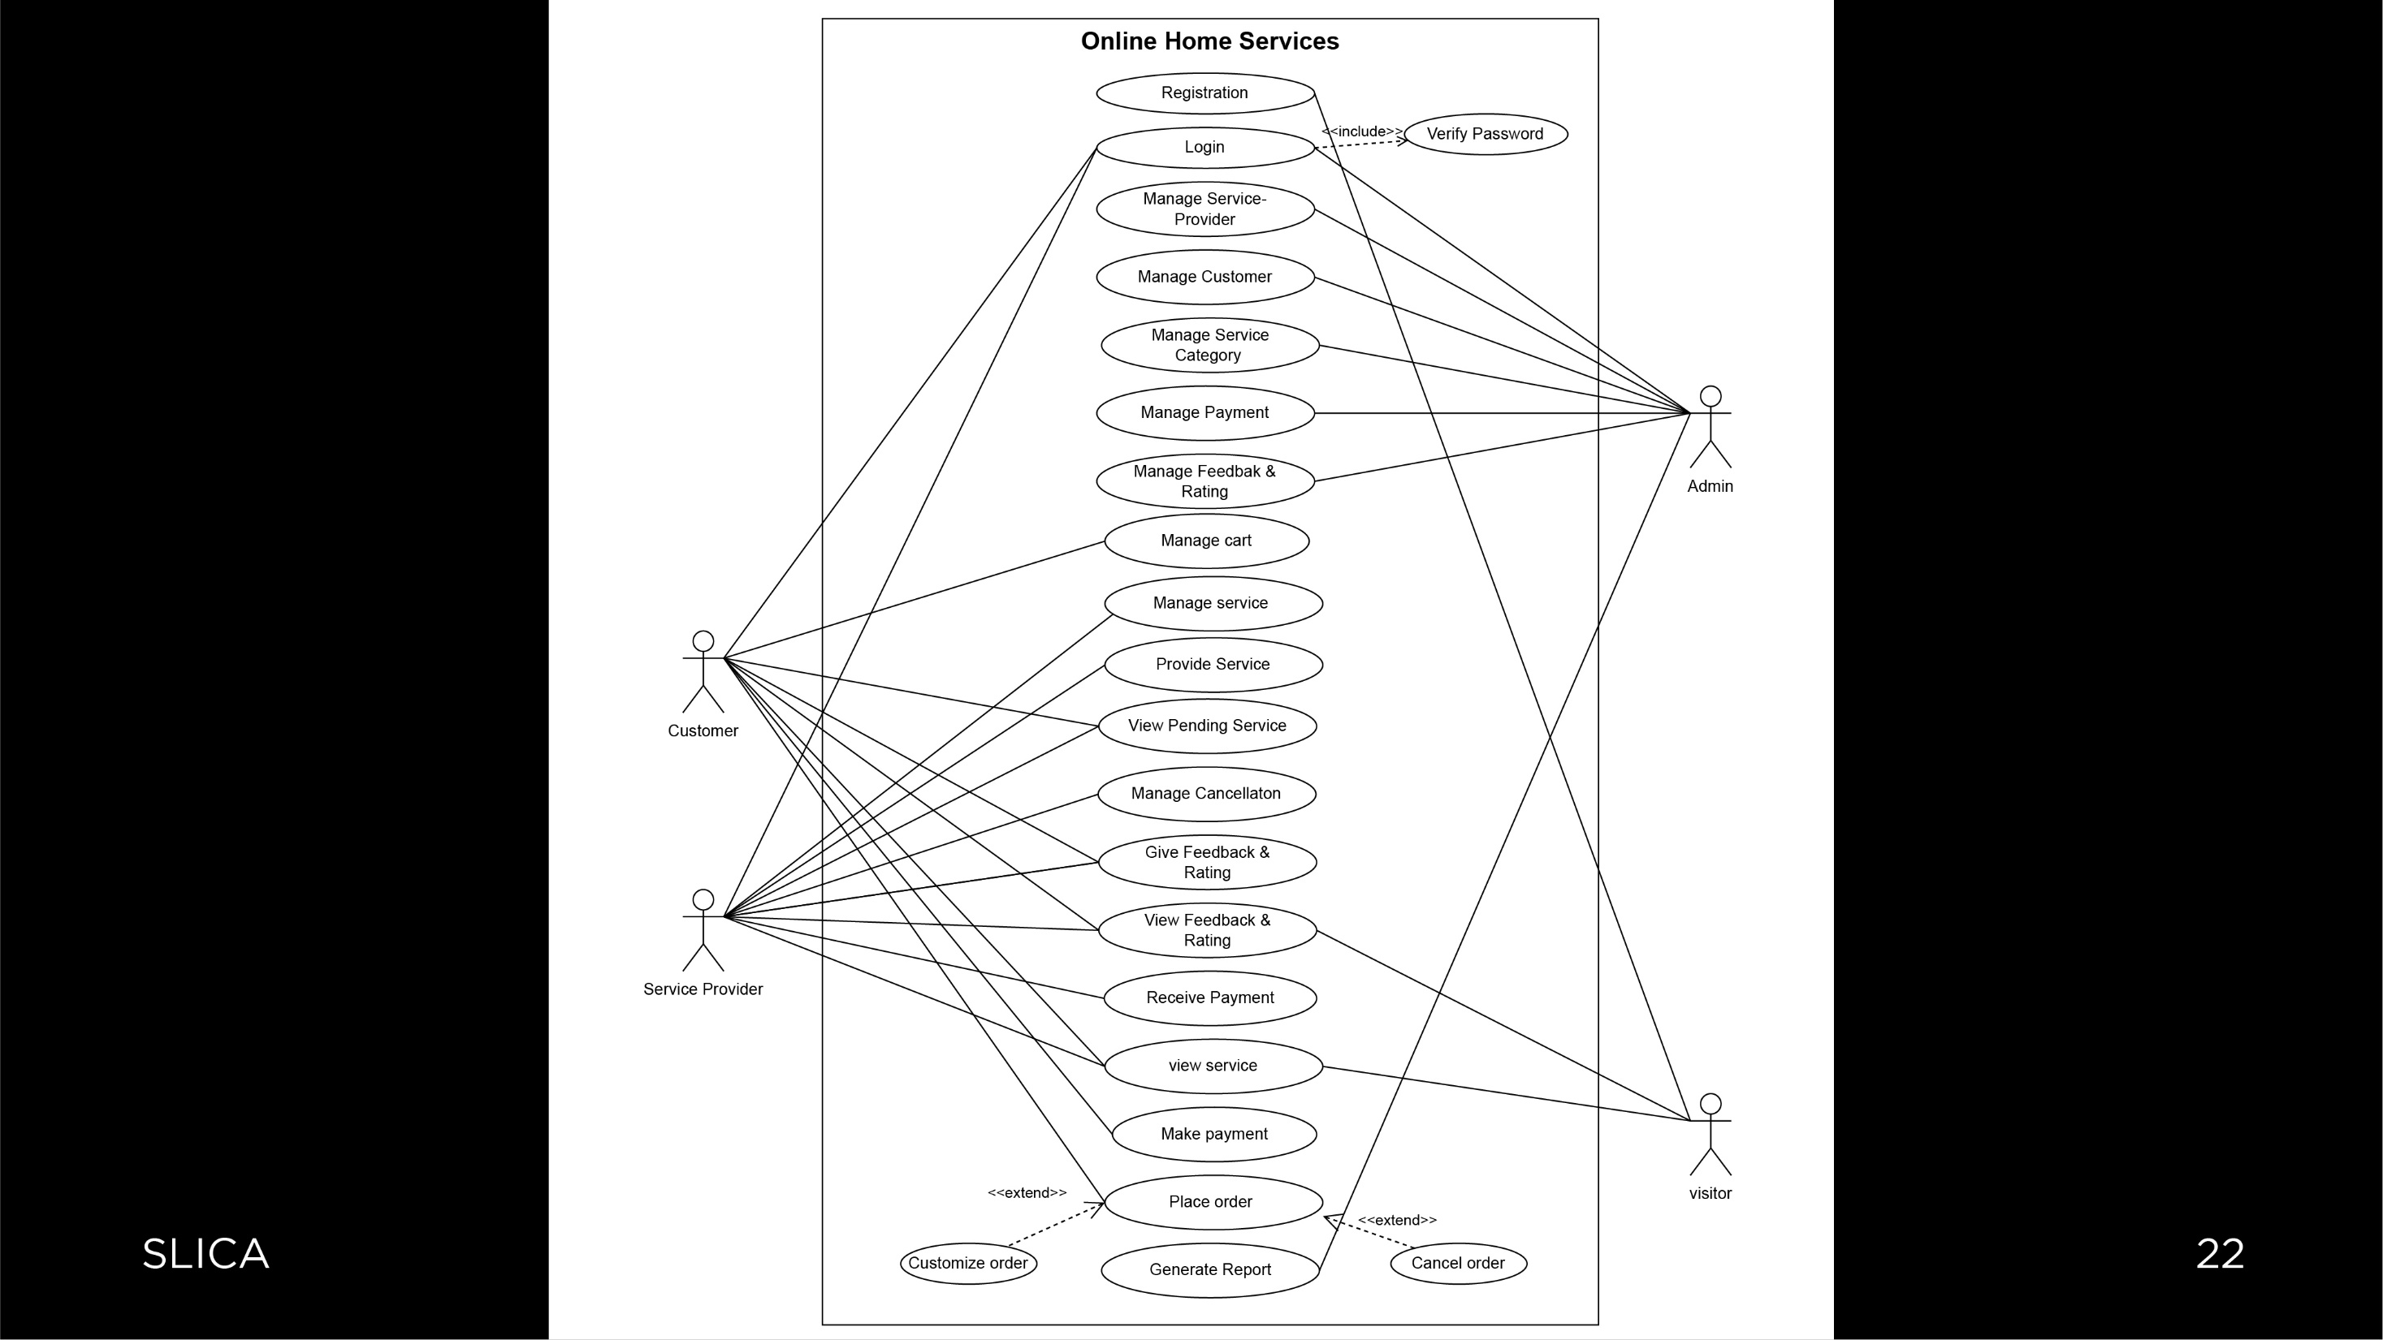

Slide 26


Slide 27
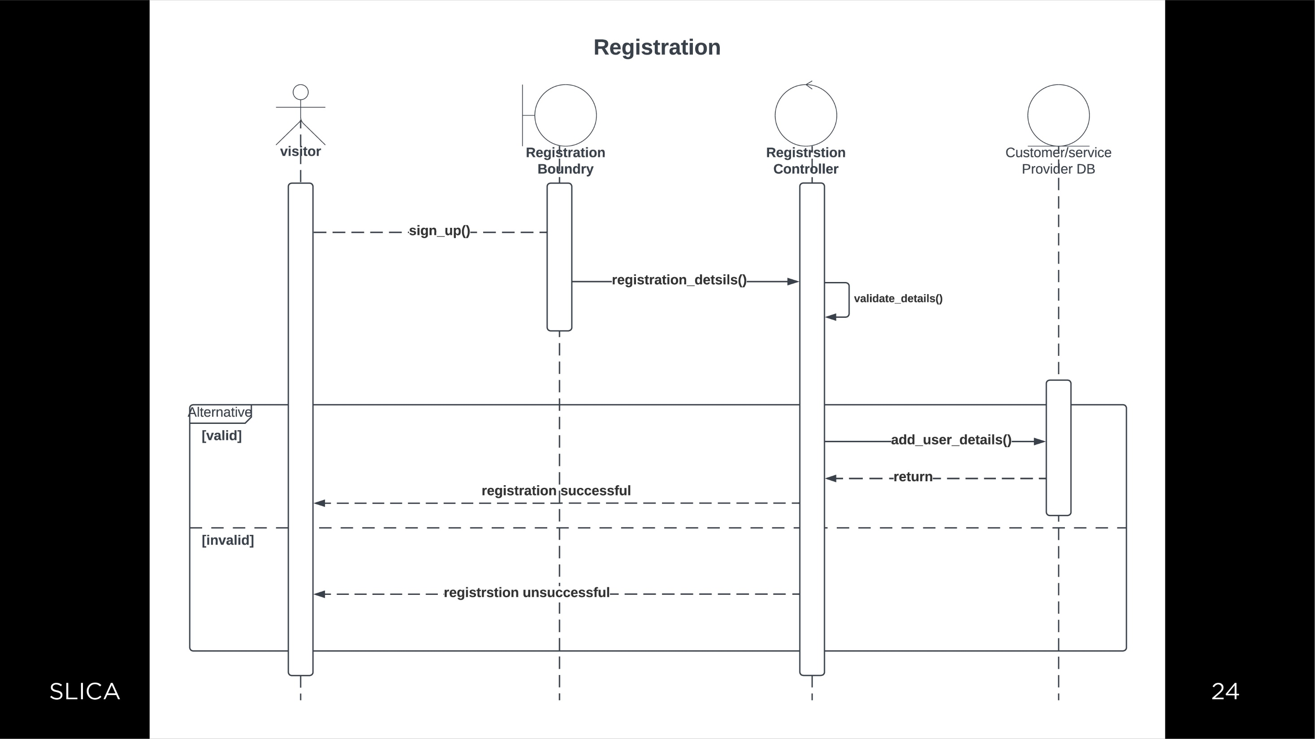

Slide 28
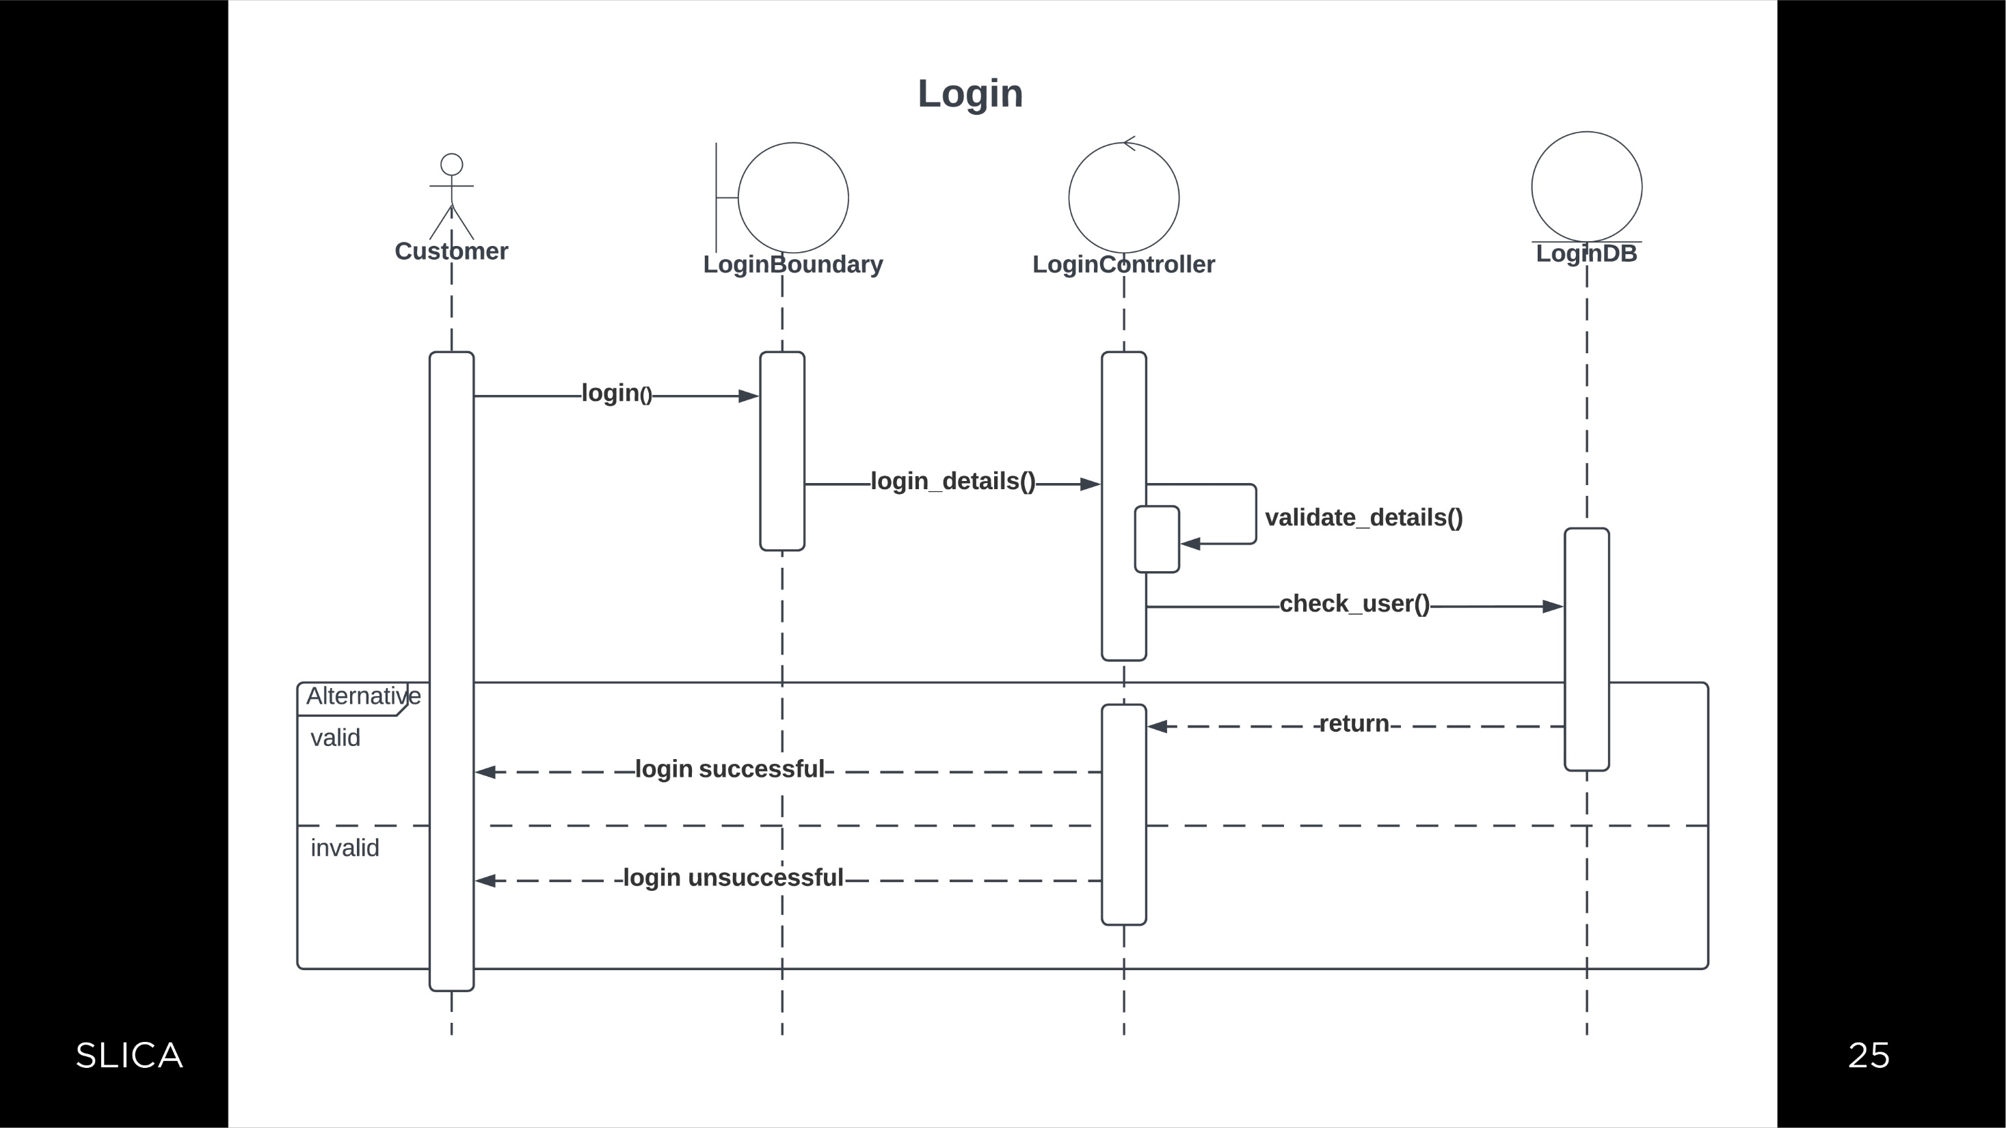

Slide 29
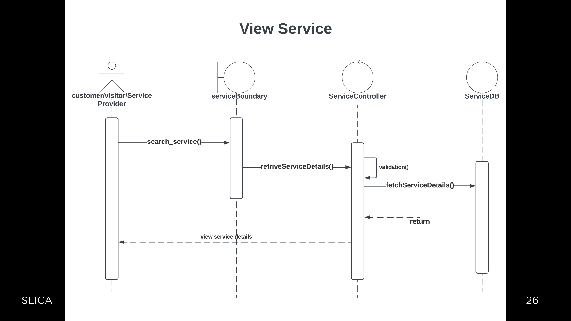

Slide 30
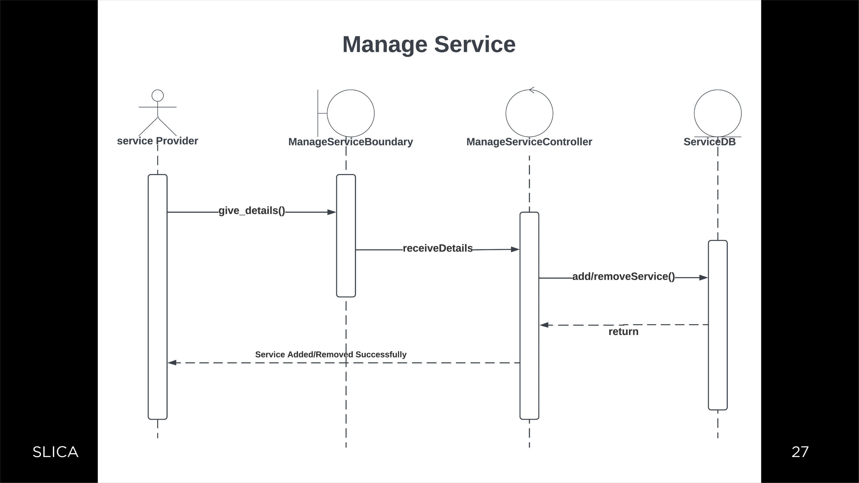

Slide 31
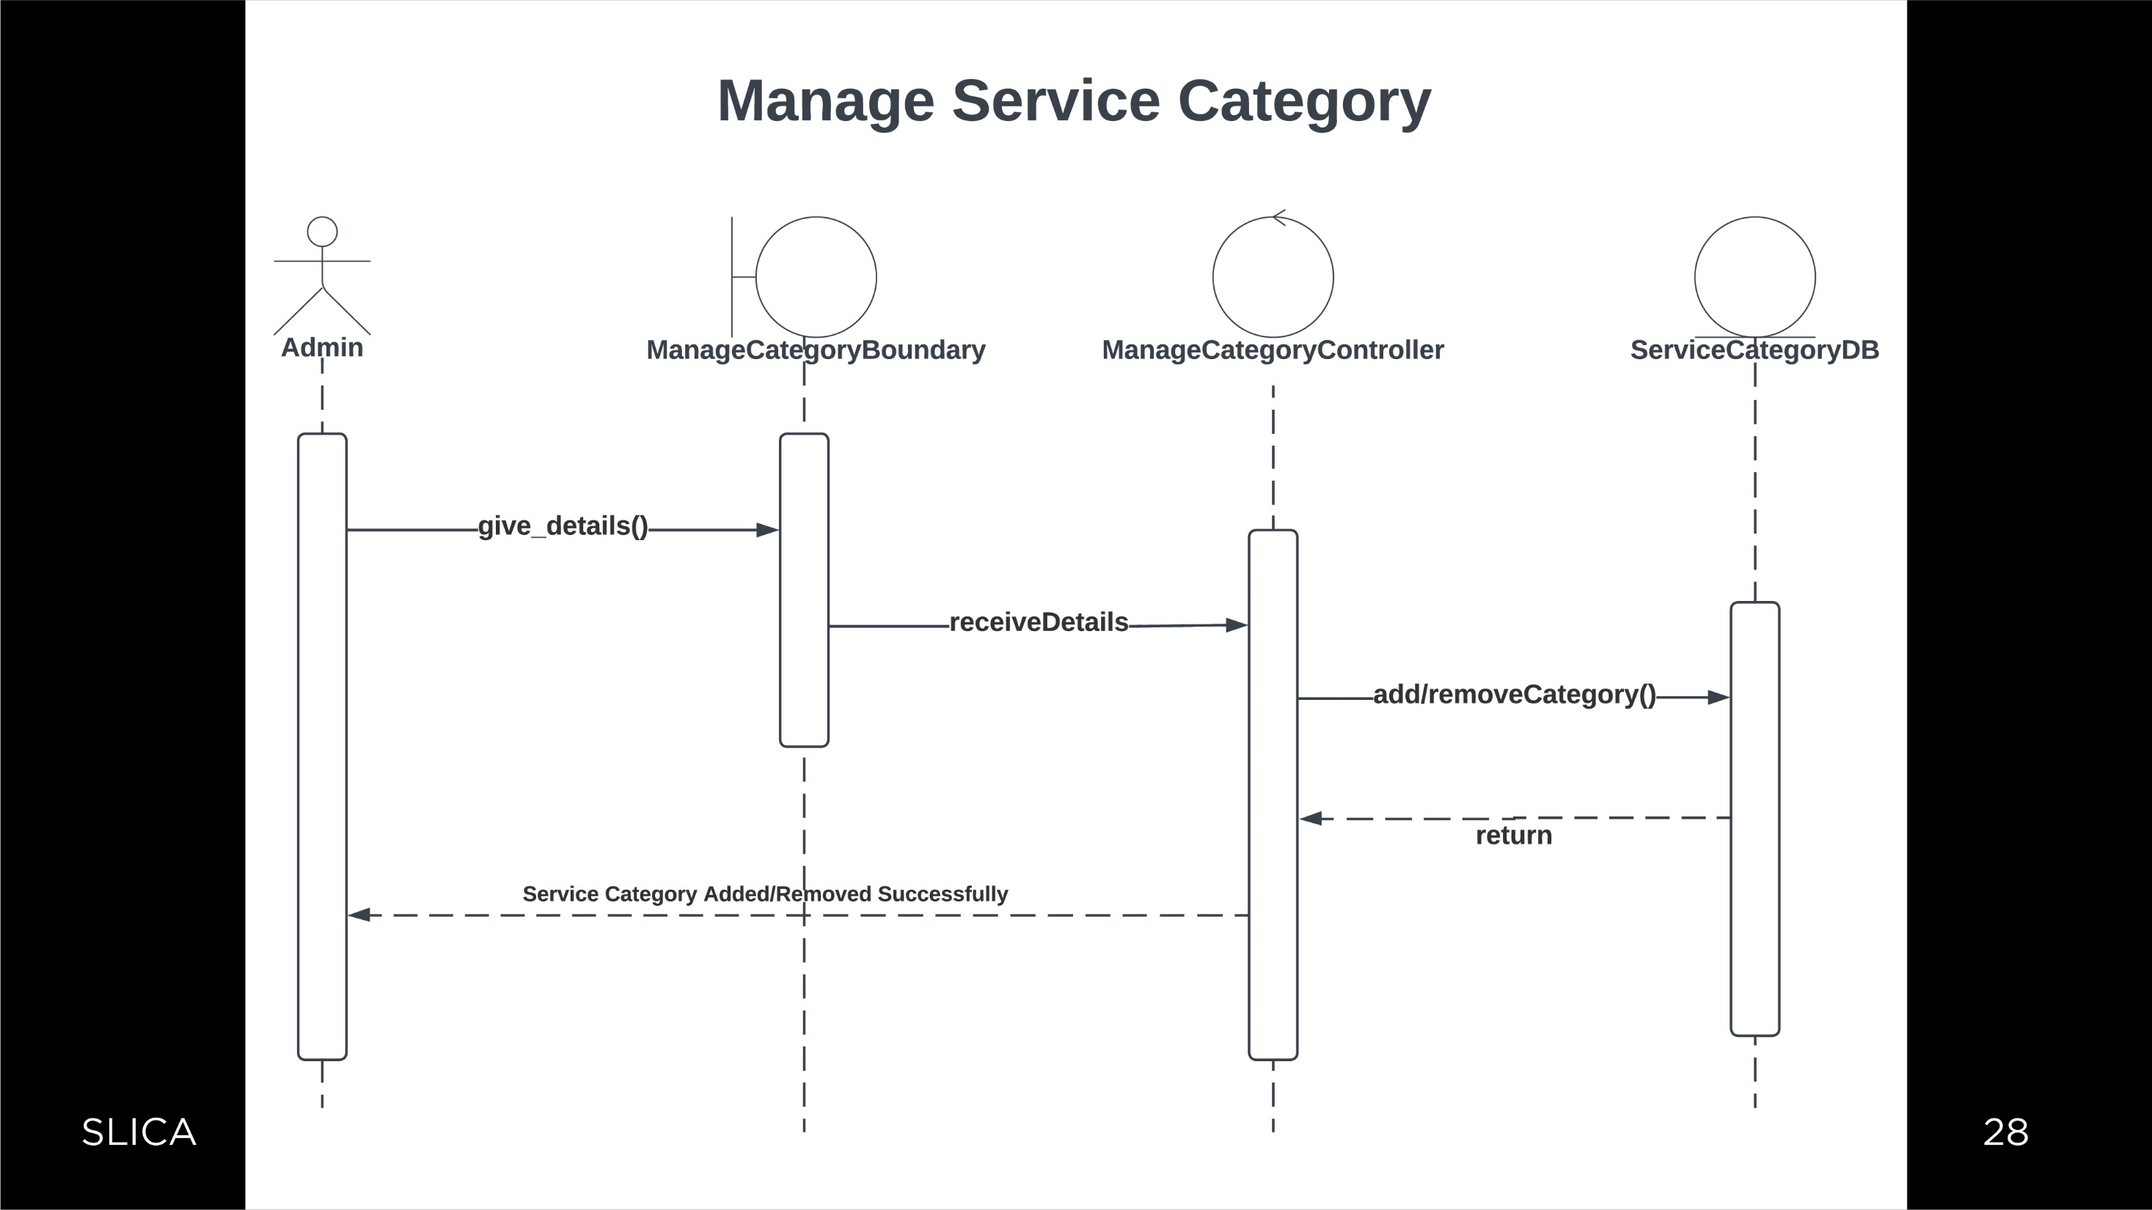

Slide 32
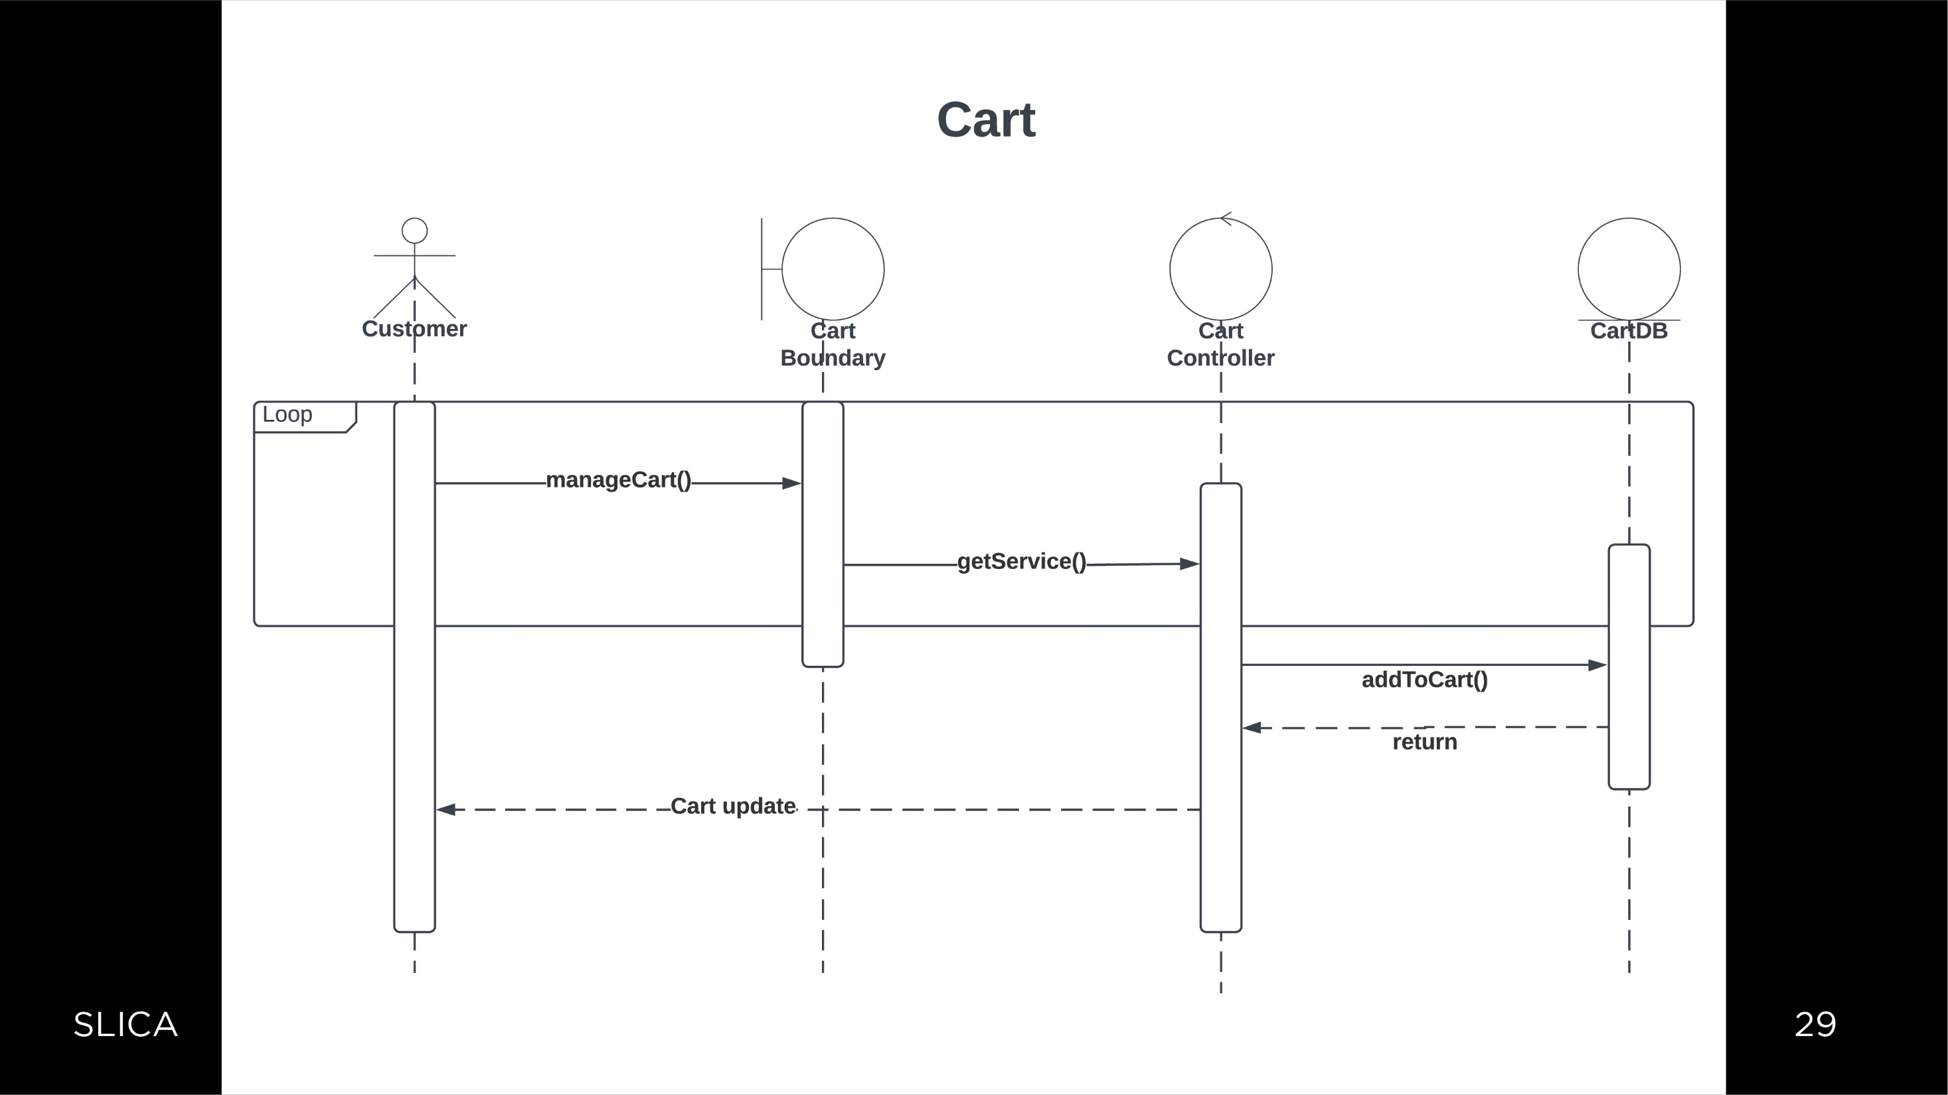

Slide 33
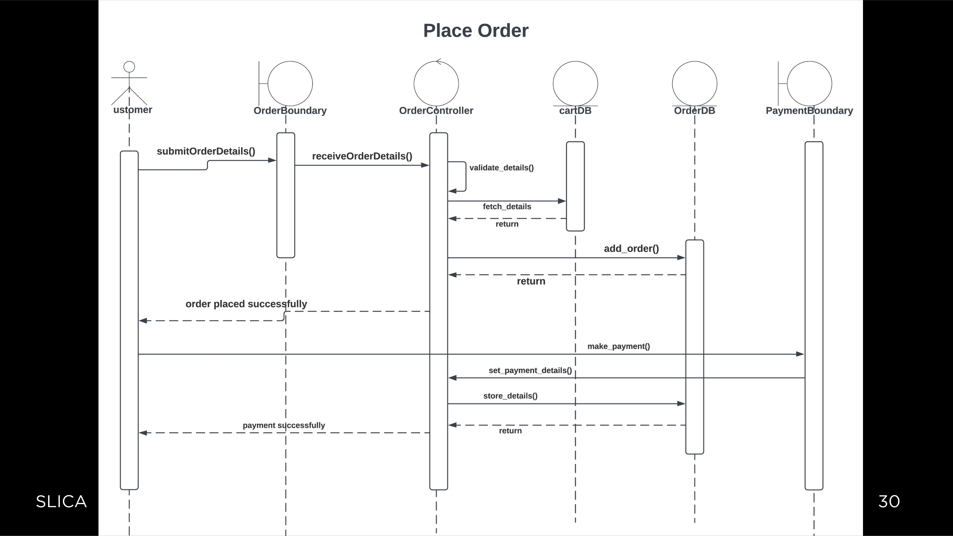

Slide 34
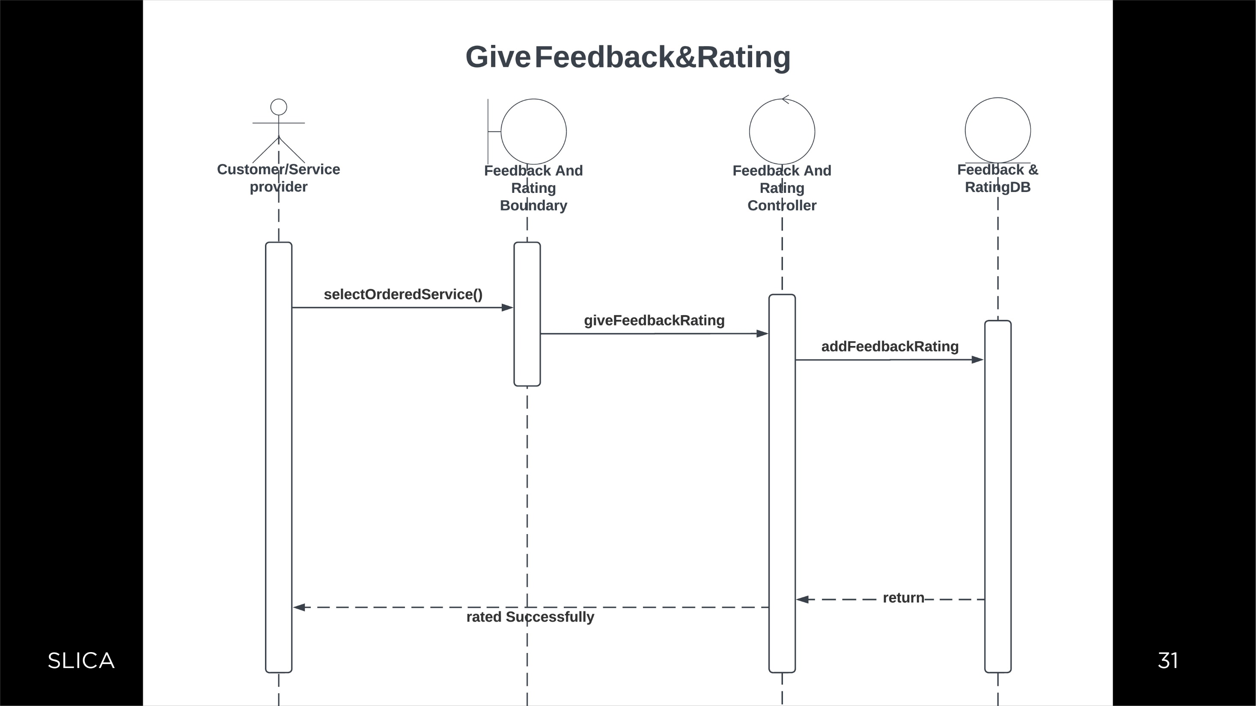

Slide 35
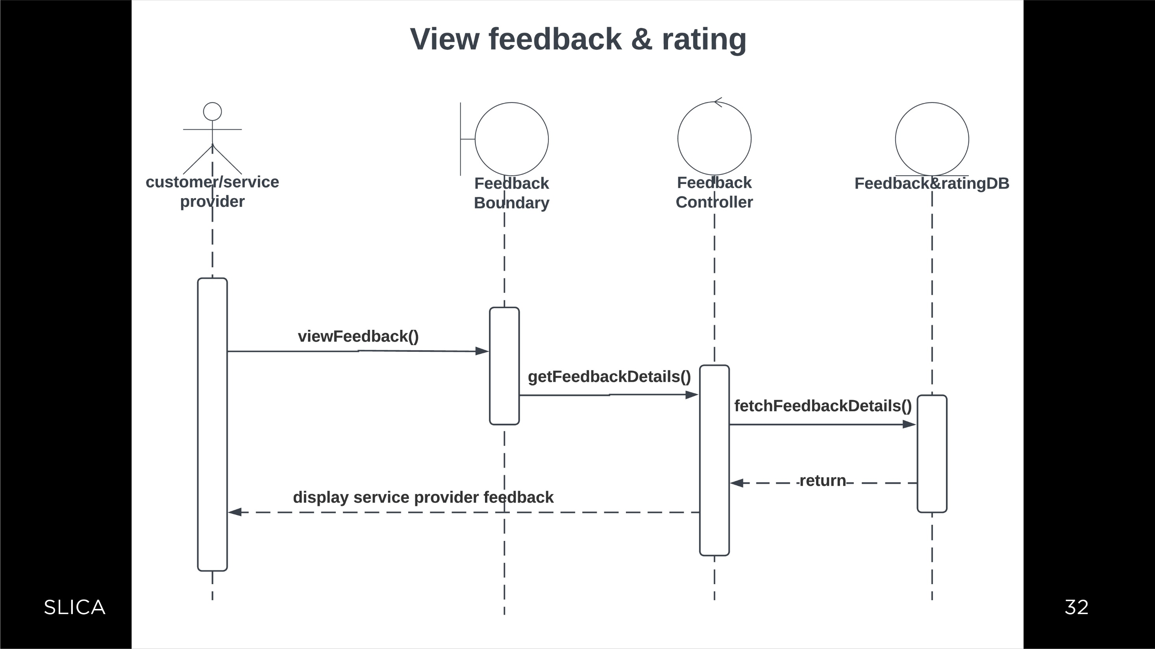

Slide 36
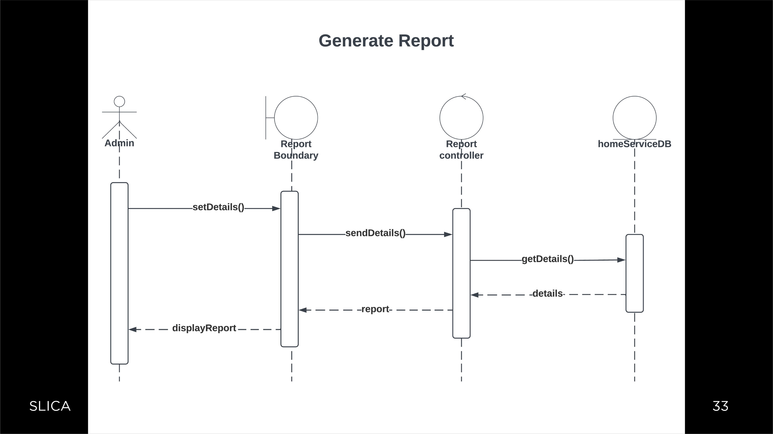

Slide 37


Slide 38
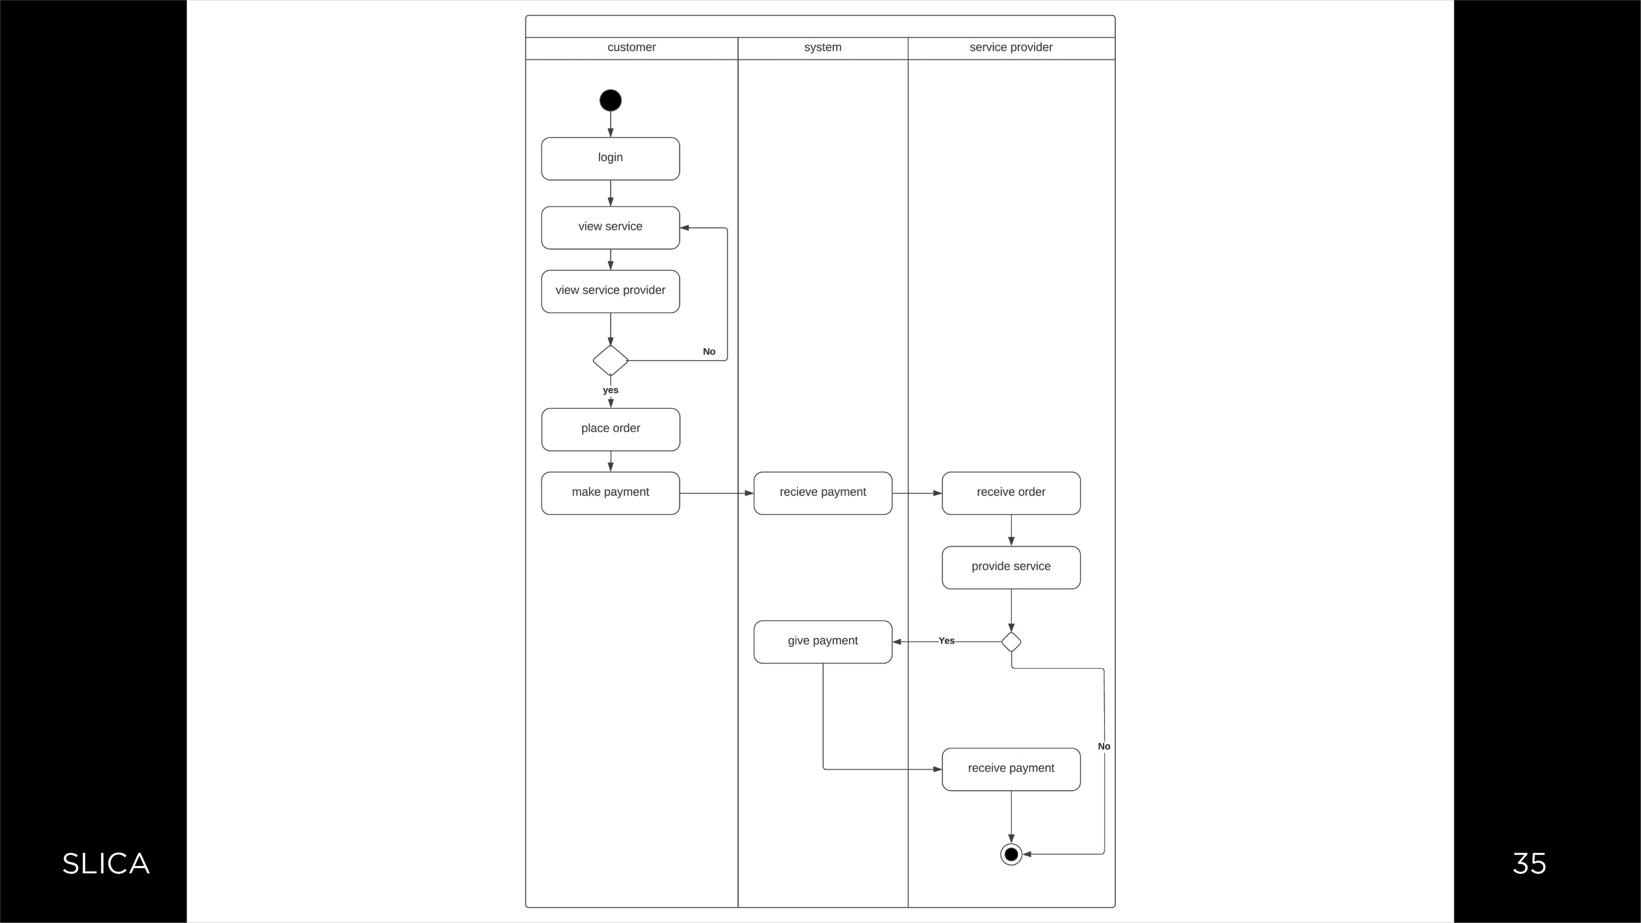

Slide 39


Slide 40
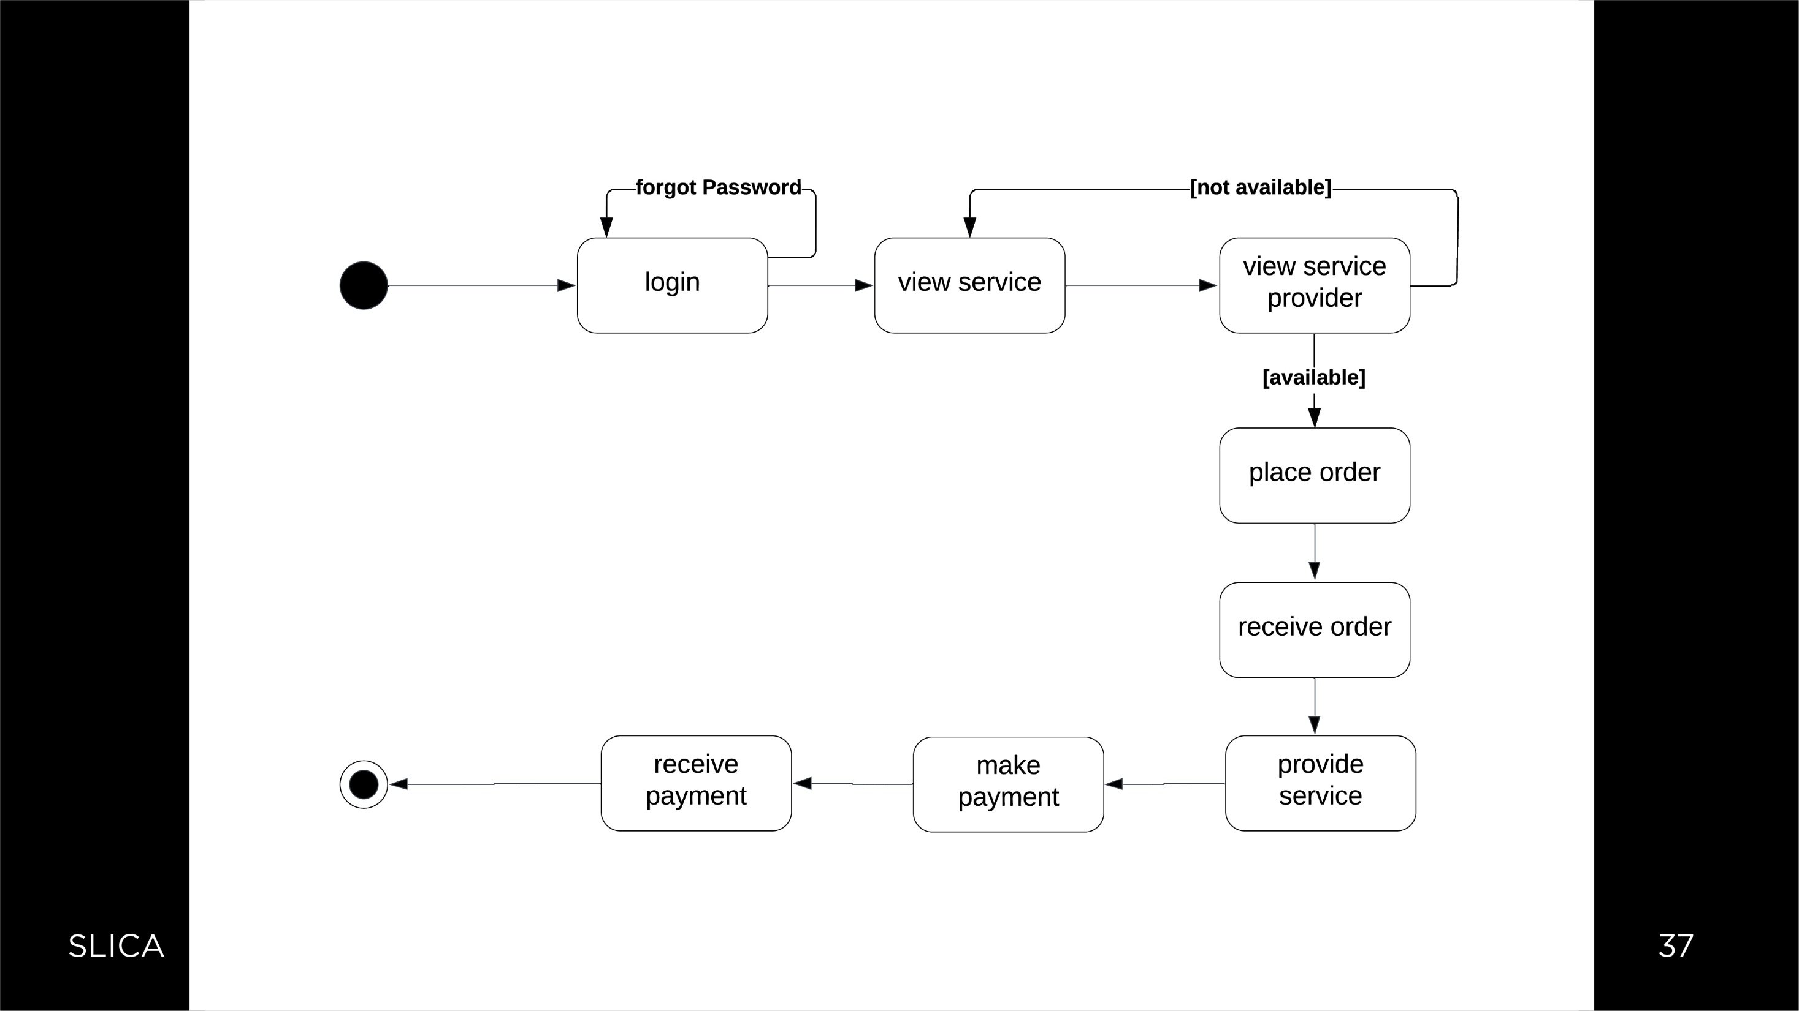

Slide 41


Slide 42
Customer
Field name | Data type | Constraints | Description
_id | Integer | Primary key | Id of customer
Login_id | Integer | Foreign key | Id of login
Area_id | Integer | Foreign key | Id of area
_firstname | Varchar(30) | Not null | Customer firstname
_lastname | Varchar(30) | Not null | Customer lastname
Address | Varchar(50) | Not null | Customer address
Phone_no | Integer | Not null | Phone no of customer
Email_id | Varchar(30) | Not null | Email of customer
Pincode | Interger | Not null | Pincode of customer

Slide 43
login
Field name | Data type | Contraints | Description
_id | Integer | Primary key | Id of login
User_name | Varchar(45) | Not null | Name of user
Password | Varchar(45) | Not null | Password of user
Role_id | Integer | Foreign key | Id of role

Slide 44
Role
Field name | Data type | Constraints | Description
_id | Integer | Primary key | Id of role
_name | Varchar(45) | Not null | Name of role

Slide 45
Service provider
Field name | Data type | Constraints | Description
_id | Integer | Primary key | Id of service- provider
Service_id | Integer | Foreign key | Id of service
Login_id | Integer | Foreign key | Id of login
Area_id | Integer | Foreign ley | Name of service-provider
_name | Varchar(45) | Not null | Name of service-provider
Phone_no | Integer | Not null | Phone_no of service provider
Address | Varchar(250) | Not null | Address of service-provider
Email_id | Varhar(45) | Not null | Email of service-provider
Pincode | Integer | Not null | Pincode of service-provider

Slide 46
Order
Field name | Data type | Constraints | Description
_id | Integer | Primary key | Id of order
serviceProvicer_id | Integer | Foreign key | Id of service-provider
Customer_id | Integer | Foreign key | Id of customer
_date | Date | Not null | Date of order
Discount | Float | Not null | Order discount
_status | Varchar(45) | Not null | Order status
Total_amount | Integer | Not null | Total amount of order
Address | Varchar(45) | Not null | Address of delivery
Pincode | Integer | Not null | Pincode of address

Slide 47
Order_details
Field name | Data type | Constraints | Description
Service_id | Integer | Primary key | Id of service
ServiceProvider_id | Integer | Primary key | Id of service-provider
Order_id | Integer | Foreign key | Id of order
Amount | Integer | Not null | Amount of order
Order_date | Date | Not null | Date of order
Qty | Integer | Not null | Quantity of order
Cancellation_date | Date | Not null | Date of cancellation
Iscancelled | Integer | Not null | Status of cancellation

Slide 48
Service
Field name | Data type | Constraints | Description
Service_id | Integer | Primary key | Id of service
_name | Varchar(45) | Not null | Name of service
_price | Integer | Not null | Price of service
ServiceProvide_id | Integer | Foreign key | Id of service-provider
Service_availibility | Integer | Not null | Availibiity of service
_description | Varchar(300) | Not null | Description of service
ServiceCategory_id | Integer | Foreign key | Id of service category

Slide 49
Service Category
Field name | Data type | Constraints | Description
_id | Integer | Primary key | Id of service category
_name | Varchar(45) | Not null | Name of category
_datails | Varchar(45) | Not null | Details of category

Slide 50
Service_provider_has_service
Field name | Data type | Constraints | Description
ServiceProvider_id | Integer | Primary key | Id of service-provider
Service_id | Integer | Primary key | Id of service
Charges | Integer | Not null | Charges of services

Slide 51
Customer feedback
Field name | Data type | Constraints | Description
Customer_id | Integer | Foreign key | Id of customer
ServiceProvider_id | Integer | Foreign key | Id of service-provider
Description | Varchar(45) | Not null | Description of feedback
Date | Date | Not null | Date of feedback

Slide 52
Customer rating
Field name | Data type | Constraints | Description
Customer_id | Integer | Foreign key | Id of customer
ServiceProvider_id | Integer | Foreign key | Id of service-provider
Ratging_value | Integer | Not null | Value of rating
Raing_Date | Date | Not null | Date of rating

Slide 53
Service_provider feedback
Field name | Data type | Constraints | Description
Customer_id | Integer | Foreign key | Id of customer
ServiceProvider_id | Integer | Foreign key | Id of service-provider
Description | Varchar(45) | Not null | Description of feedback
Date | Date | Not null | Date of feedback

Slide 54
Service_provider rating
Field name | Data type | Constraints | Description
Customer_id | Integer | Foreign key | Id of customer
ServiceProvider_id | Integer | Foreign key | Id of service-provider
Ratging_value | Integer | Not null | Value of rating
Raing_Date | Date | Not null | Date of rating

Slide 55
Delivery details
Field name | Data type | Constraints | Description
Delivery_id | Integer | Primary key | Id of delivery
_date | Date | Not null | Date of delivery
Customer_id | Integer | Foreign key | Id of customer
ServiceProvider_id | Integer | Foreign key | Id of service-provider

Slide 56
Manage cart
Field name | Data type | Constraints | Description
Service_id | Integer | Primary key | Id of service
Customer_id | Integer | Primary key | Id of customer
Qty | Integer | Not null | Quantity of service
Amount | Integer | Not null | Amount of service

Slide 57
Payment
Field name | Data type | Constraints | Description
_id | Integer | Primary key | Id of payment
Order_id | Integer | Foreign key | Id of order
Amount | Integer | Not null | Amount of payment

Slide 58
Refund
Field name | Data type | Constraints | Description
Refund_date | Date | Not null | Date of refund
Refund_amt | Integer | Not null | Amount of refund
Payment_id | Integer | Foreign key | Id of payment

Slide 59
Area
Field name | Data type | Constraints | Description
Area_id | Integer | Primary key | Id of area
_name | Varchar(45) | Not null | Name of area
City_id | Integer | Foreign key | Id of city

Slide 60
City
Field name | Data type | Constraints | Description
City_id | Integer | Primary key | Id of city
_name | Varchar(45) | Not null | Name of city
State_id | Integer | Foreign key | Id of state

Slide 61
State
Field name | Data type | Constraints | Description
State_id | Integer | Primary key | Id of state
_name | Varchar(45) | Not null | Name of state

Slide 62


